Slide 1

High Performance Computing for genomic applications
Linux re-fresh
Scientific IT Services
Michal Okoniewski

Slide 2
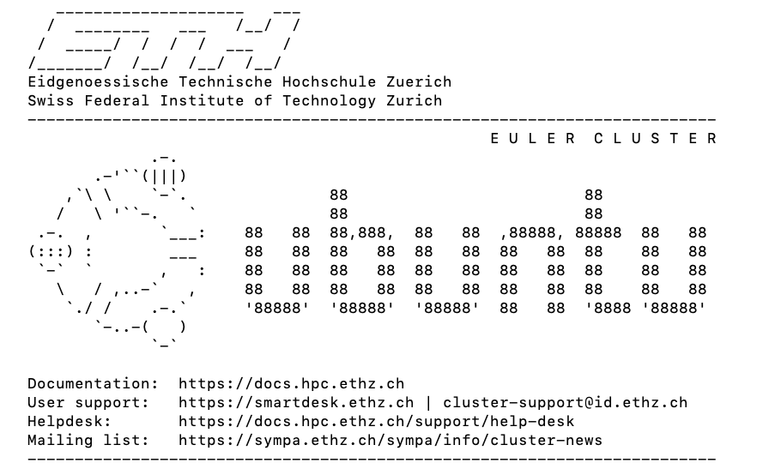
Linux
Linux is an operating system with UNIX-like kernel
Euler cluster uses Ubuntu distribution
There are many similartities with other flavours/dialects, eg macOS

Slide 3
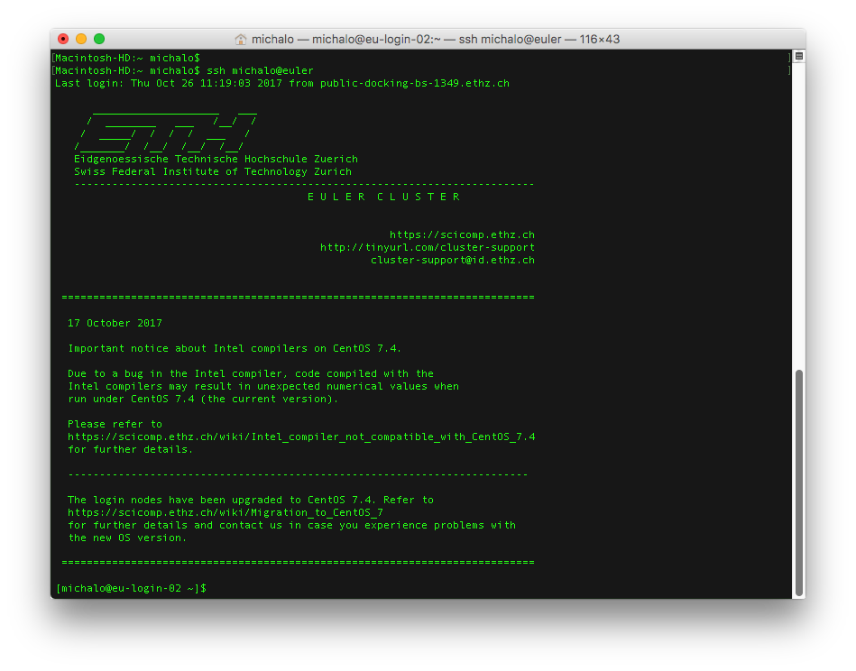
Logging in to EULER cluster
  ssh username@euler.ethz.ch

Slide 4
File system
Access to a file or directories can be described with a path
Full path starts with “/” and has a slash for every sub-directory
Relative path refers to the current directory
Your home directory: /cluster/home/michalo
  Can be accessed also as: ~/
Single dot in the path stands for “current directory”
Double dot in the path “one directory up in the hierarchy”

Slide 5
Moving around filesystem
Change directory:
  cd /cluster/home/michalo/project_michalo/course_BSSE
  cd my_data
  cd ~/my_data
Back home
  cd ~/
  cd
  cd /cluster/home/your_username
See: https://scicomp.ethz.ch/wiki/Linux_command_line#cd

Slide 6
Moving around filesystem
Back one or more level up
  cd ..
  cd ../..
Show current directory
  pwd
See: https://scicomp.ethz.ch/wiki/Linux_command_line#pwd

Slide 7
Directory content listing
Standard listing of the content
  ls
Full listing
  ls –l
Full listing sorted by the timestamp of the file, with a wildcard
  ls –lt *bam
See: https://scicomp.ethz.ch/wiki/Linux_command_line#ls

Slide 8
Creating directories and files
New directory in a current one
  mkdir my_data
New directory using a full path
  mkdir ~/my_data/genomics1
New empty file
  touch ~/my_data/README
See: https://scicomp.ethz.ch/wiki/Linux_command_line#mkdir

Slide 9
Copying and moving files and directories
cp [source] [destination]
mv [source] [destination] - also used to rename
  cp README my_data/genomics1
  cp ~/my_data/README ~/my_data/genomics1/README
  cp ~/my_data/READ* /cluster/home/michalo/genomics1/README
  mv ~/my_data/genomics1/README ~/
Recursive copy – directory with sub-directories and content
  cp -r ~/my_data/genomics1 ~/
  See: https://scicomp.ethz.ch/wiki/Linux_command_line#cp

Slide 10
Copying from and to another machine or cluster
scp [username]@[machine1]:[machine1source] [local_destination]
Or other way round, from local to cluster:
  scp myfile.txt michalo@euler.ethz.ch:~/my_data
Side topic: generating and using private-public key pair

Slide 11
File permissions
Add external users read and directory listing access in your home directory
  chmod a+rx ~/
Add writing permissions
  chmod a+w documentation.txt
Remove access to particular file
    chmod a-rw documentation.txt
    chmod 700 documentation.txt
See: https://scicomp.ethz.ch/wiki/Linux_permissions

Slide 12
Displaying content of files
  less README
  cat ~/ README
  more README
  head README
  tail –n 20 README
See: https://scicomp.ethz.ch/wiki/Linux_command_line#less.2C_cat.2C_more

Slide 13
Text editors

Slide 14
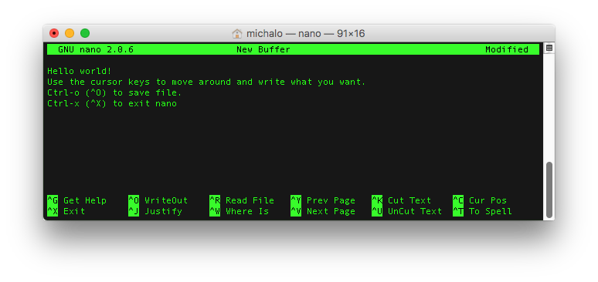
Text editors - nano

Slide 15
Text editors

Slide 16
Other tricks with commands
Pipes to another process
  ls | wc
Re-directing output to a file
  ls > files.txt

Slide 17
More information
https://scicomp.ethz.ch/wiki/Linux_command_line
https://scicomp.ethz.ch/wiki/Linux_permissions
  for the manual with the list of options:
  man [command]

Slide 18

Linux
Thank you!

