Slide 1

High Performance Computing for genomic applications
Genomic data formats
Scientific IT Services
Michal Okoniewski

Slide 2
Genomic data formats
Sequence
  fasta, fastq
alignment formats
  SAM, BAM, CRAM
Variant description
  VCF, BCF
Annotation
  GTF, GFF
Genomic ranges
  BED, WIG, bigWIG

Slide 3
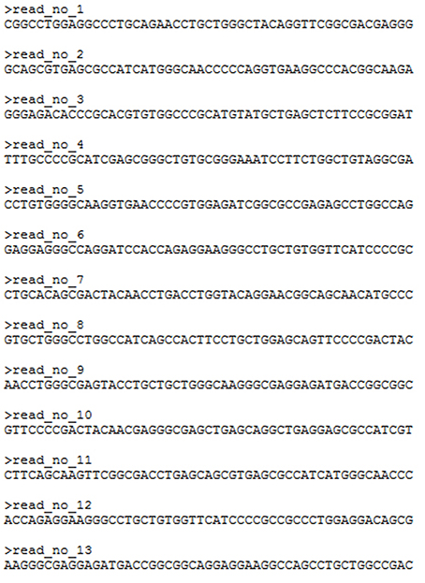
Raw sequence data: fasta

Slide 4
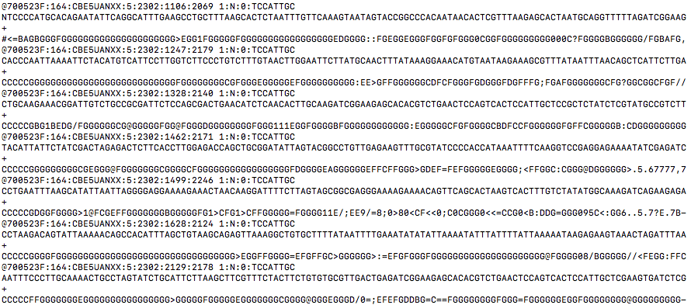
Raw sequencing data: fastq

Slide 5
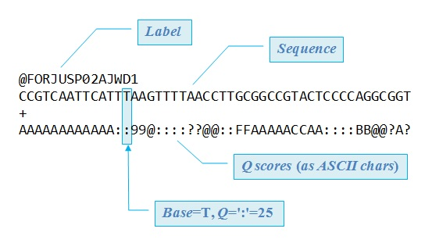
Fastq record structure

Slide 6
PHRED scores
Quality as PHRED score
Phred+33 in ASCII:
!"#$%&'()*+,-./0123456789:;<=>?@ABCDEFGHI
0........................26...31.......40
https://github.com/brentp/bio-playground/blob/master/reads-utils/guess-encoding.py
Phred Quality Score | Probability of incorrect base call | Base call accuracy
10 | 1 in 10 | 90%
20 | 1 in 100 | 99%
30 | 1 in 1000 | 99.90%
40 | 1 in 10,000 | 99.99%
50 | 1 in 100,000 | 100.00%
60 | 1 in 1,000,000 | 100.00%

Slide 7
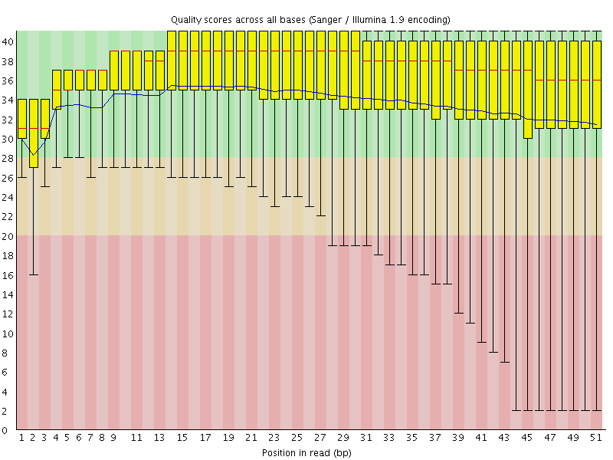
Fastqc – per base sequence quality check

Slide 8
Fastqc – per base sequence quality check

Slide 9
What can be done with raw sequences
Quality filtering and summaries (picard/htsjdk,…)
Trimming (cutadapt, trimmomatic,…)
Alignment (bowtie, bwa, SHRiMP, STAR,…)
De-novo assembly (Trinity, velvet, SPADES, SOAPdenovo…)
…

Slide 10
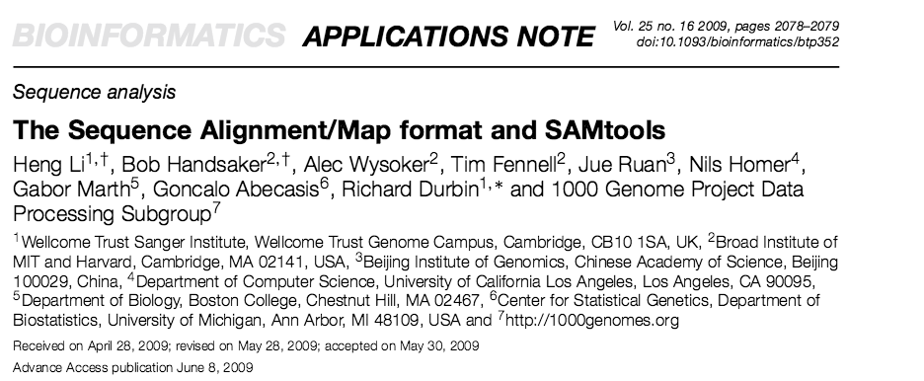
Alignment formats - SAM
https://samtools.github.io/hts-specs/SAMv1.pdf

Slide 11
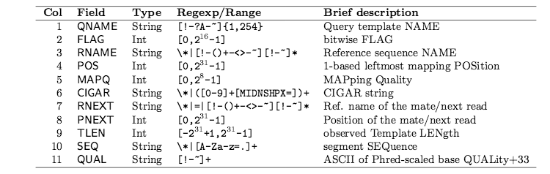
Alignment formats - SAM
Fields of a record in SAM format

Slide 12
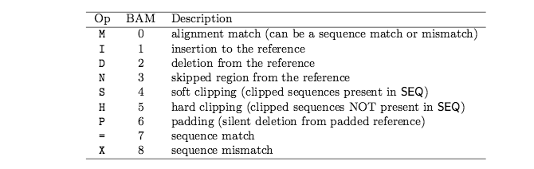
SAM format – CIGAR strings
Example: 26M987N22M1S

Slide 13
Alignment formats - SAM
@SQ SN:chrM LN:16571
@SQ SN:chr1 LN:249250621
@SQ SN:chr2 LN:243199373
@SQ SN:chr3 LN:198022430
SRR1012931.32 0 chr12 52632509 255 1S48M * 0 0 NGTGGATGCCCTGAATGATGAGATCAACTTCCTCAGGACCCTCAATGAG
BP\cceeegggggiiiiiihiihihiiiiiiiiiiiihiiibghhiiii NH:i:1 HI:i:1 AS:i:47 nM:i:0
SRR1012931.33 16 chr16 88925155 255 48M1S * 0 0 GGAGCTGTACCTGGGCCTGCTCTACCCCACGGAGGACTACAAGGTATAC
iiiihhheciiiiiiiiihiihgeiiiihhiiiiiigggggeeeeebab NH:i:1 HI:i:1 AS:i:45 nM:i:1
SRR1012931.34 16 chr17 60111322 255 24M1478N24M1S * 0 0 TTAGTCCAAATGGGCATAAGATAACTTGAAATGGGCTATTAGACTGTTN iiiiiiiiiiiigebihiiiihhhiiiiiiiiiiiigggggeceec\SB NH:i:1 HI:i:1 AS:i:45 nM:i:0
SRR1012931.35 16 chr20 20031227 255 43M6S * 0 0 CAGCAGTTATCTGTACCTCAGCCGGGGCTTTGTTTTTCACCTTGGCCAN
fhfhhghehiiighfghgfhhgfhhgbfhihdihihgc`feccecaYPB NH:i:1 HI:i:1 AS:i:42 nM:i:0
SRR1012931.36 0 chr3 48680414 255 49M * 0 0 GCCTTGCCTCCTCAGGCGCTGCCTTCCTGCCCAGACAGGCTGGCATCCA
bbbeeeeeggggghfgbfgfhiiiihihhihiffcghiiihiiifgiih NH:i:1 HI:i:1 AS:i:48 nM:i:0
SRR1012931.37 16 chrX 70510616 255 26M987N22M1S * 0 0 AAATGGGCAACAGGCCAGCAGCCAAAATGAAGGCTTGACTATTGACCTN ihg`fagfafcgf\gggeigfeifhhhhfhiiiiiigggggcccaa\PB NH:i:1 HI:i:1 AS:i:45 nM:i:0
SRR1012931.38 0 chr5 139928964 255 1S48M * 0 0 NTGACTTGTTAGTTCCAGGCCTCCTTTAGTTCTGAGGCAGCTAGACCAG
BP\cceeegggggiiiiihiiiiiiiifhhihiiggfghhhihiiiihg NH:i:1 HI:i:1 AS:i:47 nM:i:0
SRR1012931.39 16 chr11 6477532 255 49M * 0 0 CGGAAGACGAGCTCATCCTCAATTGGGTTGTCCTTTCGTTTGCCGCCTG eegggggiihgiffffiihhiiiiiiiiiihghiiigggggeeeeebbb NH:i:1 HI:i:1 AS:i:48 nM:i:0
SRR1012931.40 0 chr2 3502293 255 49M * 0 0 GTGGGAGCTCTTCCCCCTACCACTCCCCACCCCAAGGCATCATTTTGGA bbbeeeeegggggiiiiiiiiiihiiiihiiii_efffffhhihhiehc NH:i:1 HI:i:1 AS:i:48 nM:i:0
SRR1012931.41 0 chr8 38099785 255 49M * 0 0 GTTTCCTTGAACTTGCTACAGACACATTTTAAGAAAGCCCAAGAAAATC
babeeeeeggggghiiiiiiiiiiiiiiiiihhiiiiiiiiiiiiihgh NH:i:1 HI:i:1 AS:i:48 nM:i:0
SRR1012931.42 0 chr1 175891126 3 49M * 0 0 CTGTACTGGAGCCACCCGCGAAAATTCGGCCAGGGTTCTCGCTCTTGTC
bbbeeeeegggggiihiiiheihhgighiiiihiihiiiiiihfgggcd NH:i:2 HI:i:1 AS:i:48 nM:i:0

Slide 14
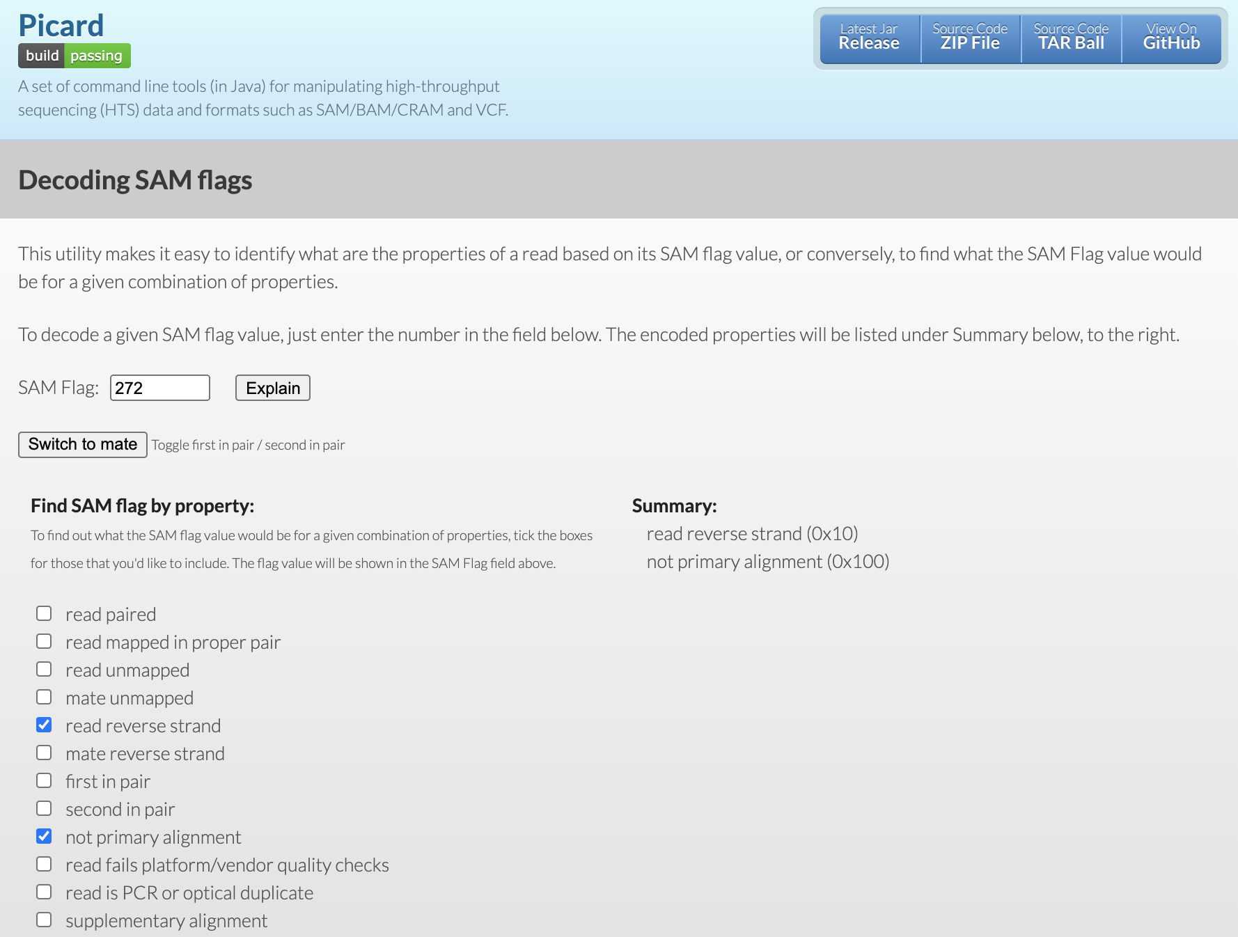
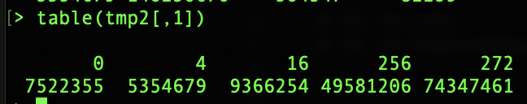
Bitwise SAM flags
https://broadinstitute.github.io/picard/explain-flags.html

Slide 15
Alignment formats - BAM
BGZF compressed SAM
Indexed with R-tree (BAI file)
BAM and BAI must be placed together
BAM files may be viewed in the IGV browser
Other formats available: CRAM, ADAM

Slide 16
What can be done with the alignments
Processing formats (samtools)
  http://www.htslib.org/
Genomic feature extraction
  Variant calling (samtools pileup, GATK,…)
  Counting reads according to annotations (HTSeq, featureCount)
  Junction and isoform discovery (cufflinks, MISO,…)
Visualization (IGV,… )

Slide 17
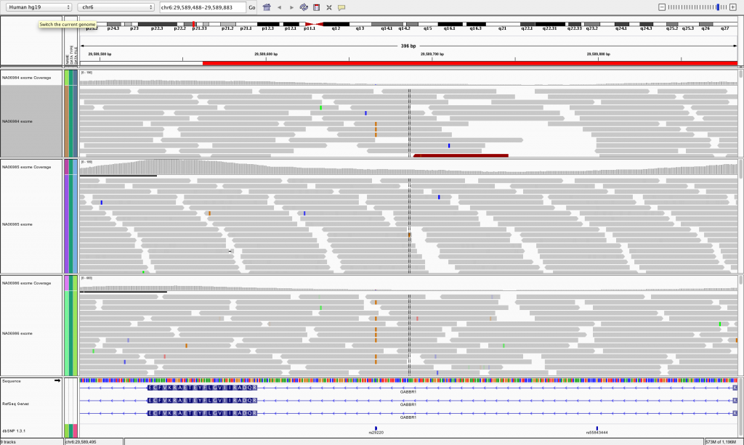
IGV browser

Slide 18
Annotation formats – GTF/GFF
seqname - name of the chromosome or scaffold; chromosome names can be given with or without the 'chr' prefix. Important note: the seqname must be one used within Ensembl, i.e. a standard chromosome name or an Ensembl identifier such as a scaffold ID, without any additional content such as species or assembly. See the example GFF output below.
source - name of the program that generated this feature, or the data source (database or project name)
feature - feature type name, e.g. Gene, Variation, Similarity
start - Start position of the feature, with sequence numbering starting at 1.
end - End position of the feature, with sequence numbering starting at 1.
score - A floating point value.
strand - defined as + (forward) or - (reverse).
frame - One of '0', '1' or '2'. '0' indicates that the first base of the feature is the first base of a codon, '1' that the second base is the first base of a codon, and so on..
attribute – (column 9) A semicolon-separated list of tag-value pairs, providing additional information about each feature.

Slide 19
Annotation formats – GTF/GFF
11 protein_coding CDS 96166204 96166448 . + 2 exon_number "2"; gene_biotype "protein_coding"; gene_id "ENSMUSG00000038700"; gene_name "Hoxb5"; p_id "P37298"; protein_id "ENSMUSP00000035423"; transcript_id "ENSMUST00000049272"; transcript_name "Hoxb5-001"; tss_id "TSS63862";
11 protein_coding exon 96166204 96167434 . + . exon_number "2"; gene_biotype "protein_coding"; gene_id "ENSMUSG00000038700"; gene_name "Hoxb5"; p_id "P37298"; transcript_id "ENSMUST00000049272"; transcript_name "Hoxb5-001"; tss_id "TSS63862";
11 antisense exon 96166296 96166395 . - . exon_number "1"; gene_biotype "antisense"; gene_id "ENSMUSG00000085645"; gene_name "0610040B09Rik"; transcript_id "ENSMUST00000140952"; transcript_name "0610040B09Rik-002"; tss_id "TSS16113";
11 protein_coding stop_codon 96166449 96166451 . + 0 exon_number "2"; gene_biotype "protein_coding"; gene_id "ENSMUSG00000038700"; gene_name "Hoxb5"; p_id "P37298"; transcript_id "ENSMUST00000049272"; transcript_name "Hoxb5-001"; tss_id "TSS63862";
11 antisense exon 96168051 96168224 . - . exon_number "1"; gene_biotype "antisense"; gene_id "ENSMUSG00000085645"; gene_name "0610040B09Rik"; transcript_id "ENSMUST00000150698"; transcript_name "0610040B09Rik-001"; tss_id "TSS73537";
11 protein_coding exon 96177998 96180537 . + . exon_number "1"; gene_biotype "protein_coding"; gene_id "ENSMUSG00000038692"; gene_name "Hoxb4"; p_id "P29329"; transcript_id "ENSMUST00000049241"; transcript_name "Hoxb4-001"; tss_id "TSS19948";
11 non_coding exon 96178479 96178588 . + . exon_number "1"; gene_biotype "non_coding"; gene_id "ENSMUSG00000092205"; gene_name "Mir10a"; transcript_id "ENSMUST00000173319"; transcript_name "Mir10a-001"; tss_id "TSS15362";
11 miRNA exon 96178479 96178588 . + . exon_number "1"; gene_biotype "miRNA"; gene_id "ENSMUSG00000065519"; gene_name "Mir10a"; transcript_id "ENSMUST00000083585"; transcript_name "Mir10a-201"; tss_id "TSS15362";
11 protein_coding CDS 96180084 96180537 . + 0 exon_number "1"; gene_biotype "protein_coding"; gene_id "ENSMUSG00000038692"; gene_name "Hoxb4"; p_id "P29329"; protein_id "ENSMUSP00000048002"; transcript_id "ENSMUST00000049241"; transcript_name "Hoxb4-001"; tss_id "TSS19948";
11 protein_coding start_codon 96180084 96180086 . + 0 exon_number "1"; gene_biotype "protein_coding"; gene_id "ENSMUSG00000038692"; gene_name "Hoxb4"; p_id "P29329"; transcript_id "ENSMUST00000049241"; transcript_name "Hoxb4-001"; tss_id "TSS19948";

Slide 20
Annotation formats
There are “dialects” of those formats
  In particular they differ on the structure of field 9
Conversion is not always possible
GFF2 < GTF < GFF3
Parsing or filtering often needed

Slide 21
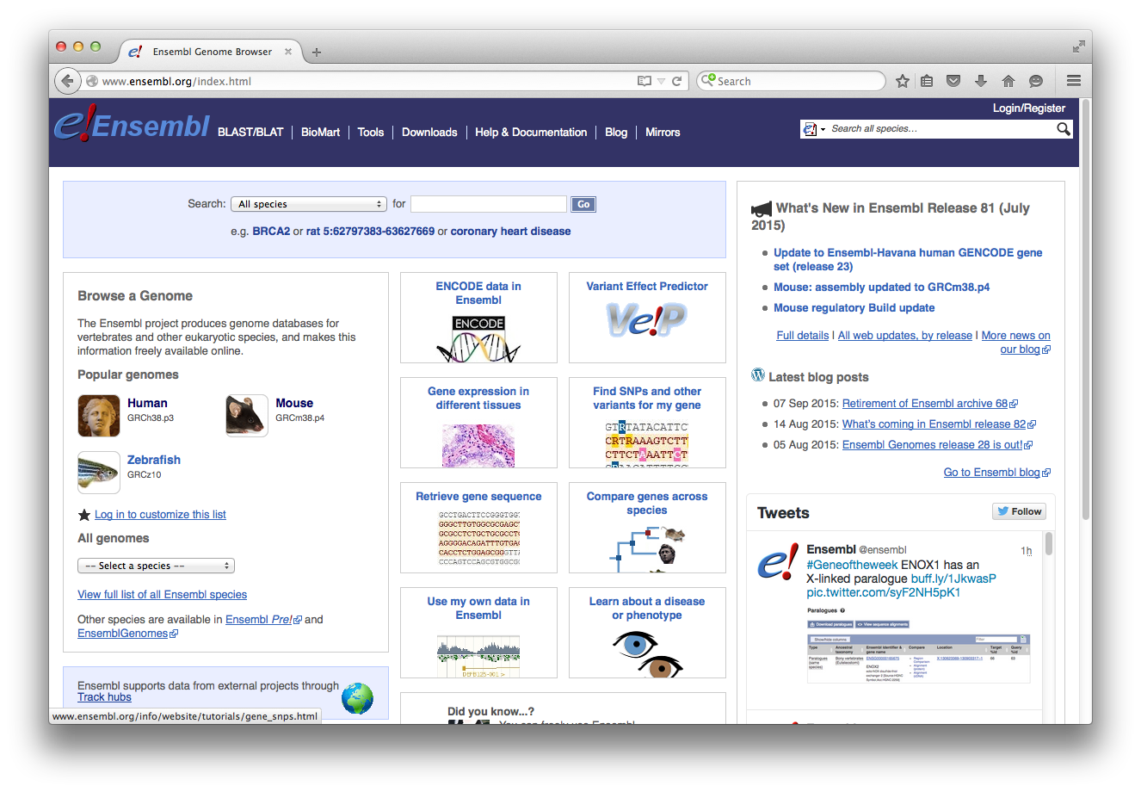
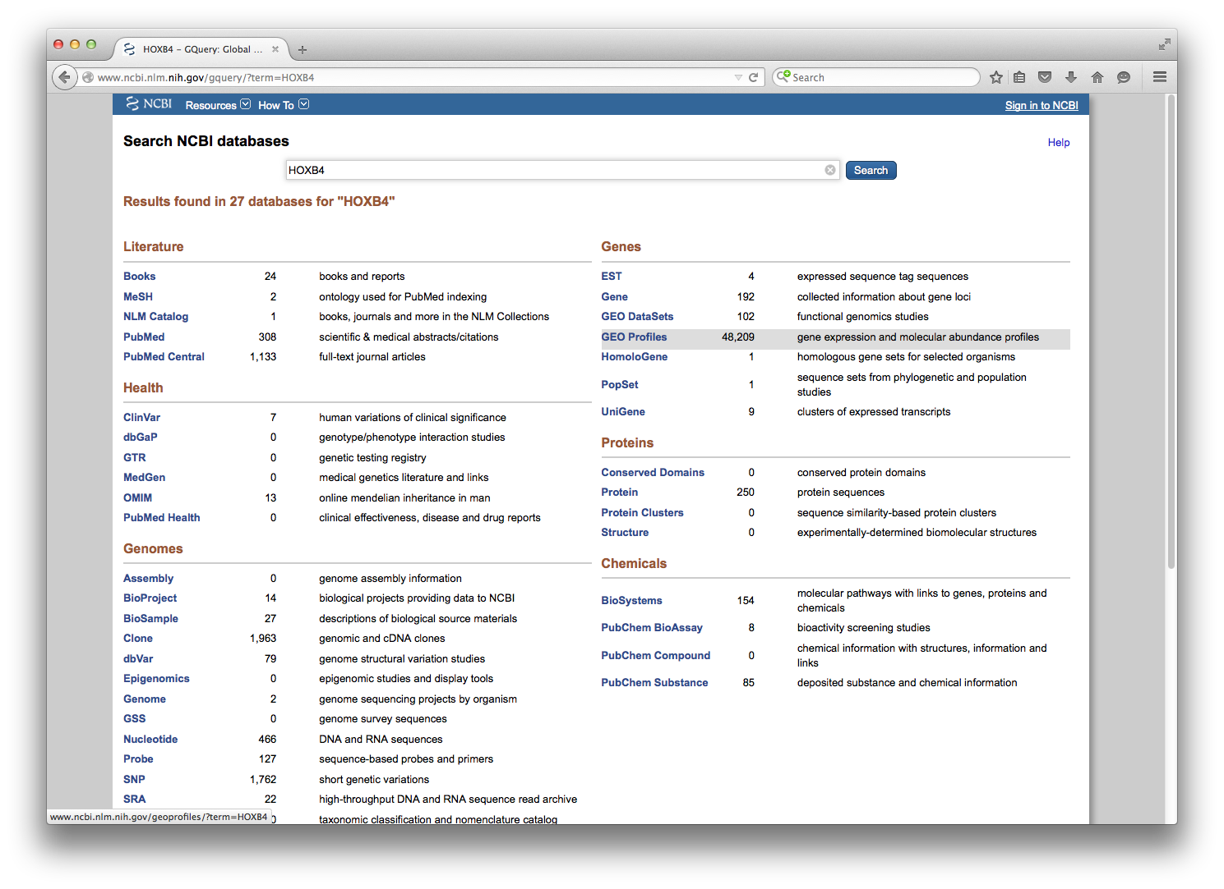
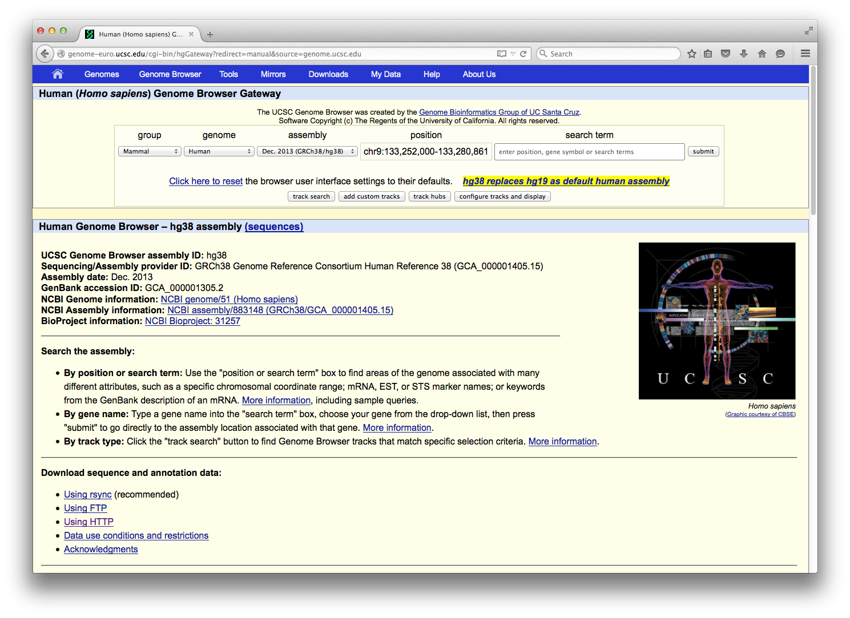
Annotation repositories

Slide 22
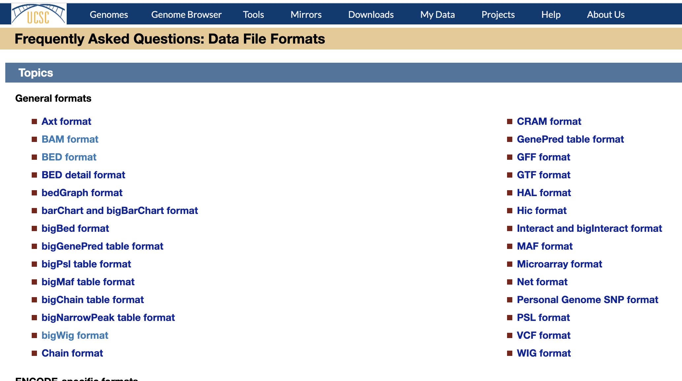
Genomic ranges formats: BED, WIG, bigWIG

Slide 23
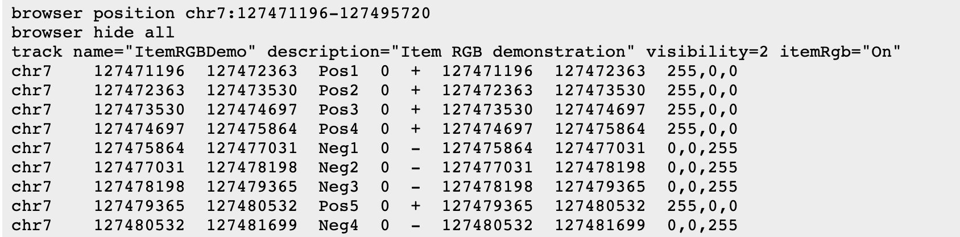
Genomic ranges formats: BED, WIG, bigWIG

Slide 24
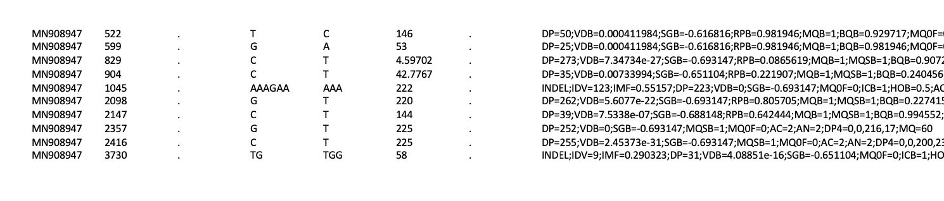
Variant Call Format - VCF
Specification: https://samtools.github.io/hts-specs/VCFv4.2.pdf

Slide 25
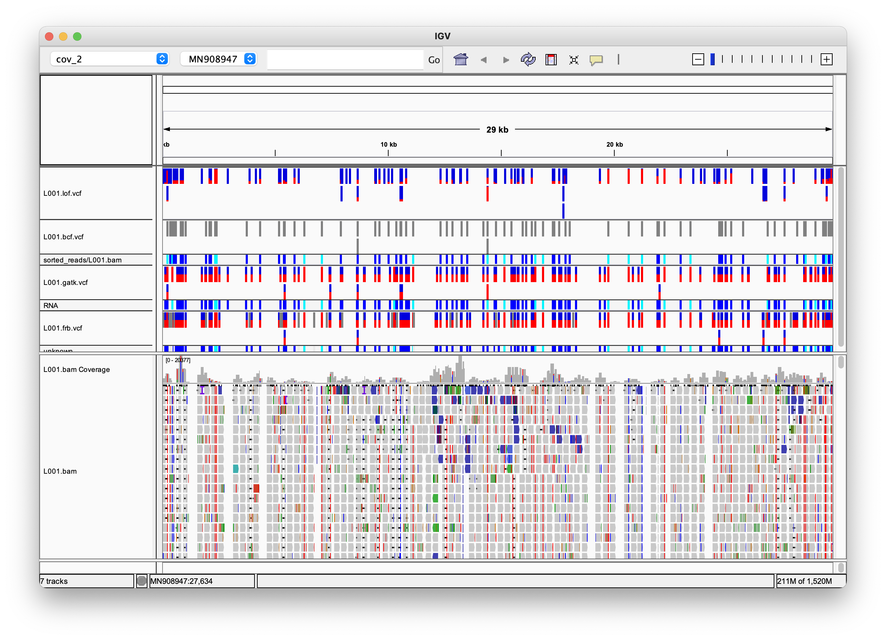
Variant Call Format – VCF, example in IGV

Slide 26
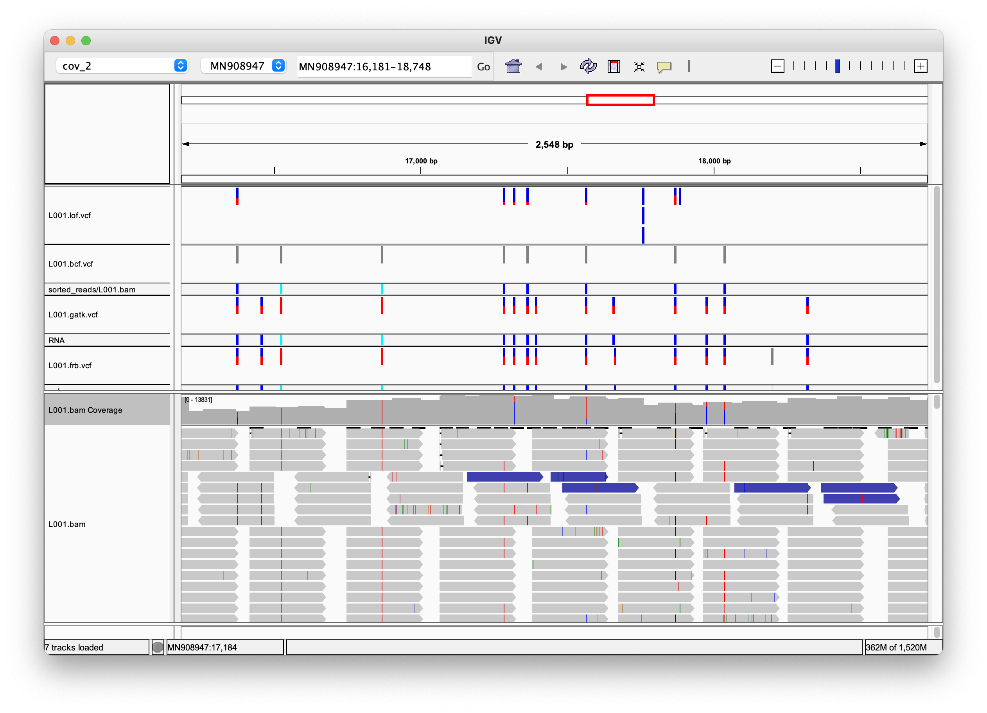
Variant Call Format – VCF, example in IGV

Slide 27
Trends to watch GA4GH
GA4GH is for genomic and health data like W3C standards for the web
  Work streams: cloud, regulatory, clinical, scaling, security…
  Driver projects
  Annual conference
  Various level of „hard evidence“
Genomic data toolkit
  https://www.ga4gh.org/genomic-data-toolkit/
  a mix of old and new formats

Slide 28
High Performance Computing for genomic applications
Additional topic: cleaning and formatting the –omics data with AWK
Scientific IT Services
Michal Okoniewski

Slide 29

What is AWK?
It is a programming/scripting language
It is ancient – developed ca 1977 BC
Created by Brian Kernighan – also known for C and Unix

Slide 30

Why AWK is cool and useful?
It works
It works quickly
It does the job

Slide 31
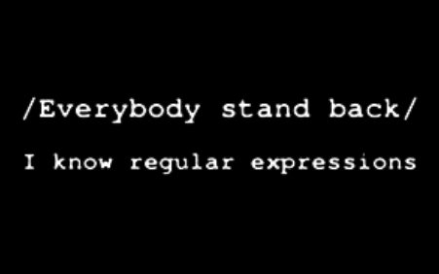
Why AWK is cool? – technically
It processes the text files, assuming that they are tables
It processed them line-by-line, row-by-row
It uses regular expressions
It is so easy and reliable that I am not afraid of a live presentation ☺

Slide 32
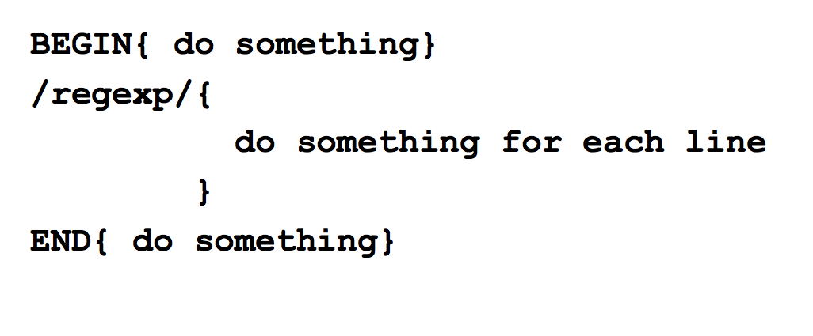
Program structure

Slide 33
However….
Just the main body of the program is necessary
Most of the programs are ad-hoc one-liners
Can be run from command line ad-hoc way:
awk '{print}' test.txt
Or run from command line using a script file:
awk -f my.awk.script test.input.txt > output.txt

Slide 34
Basics 1
Variables:
  $0 the whole row being processed right now $1, $2, $3 ... the fields in the line
  NR – number of current row
  FS – field separator
  OFS – output field separator

Slide 35
Basics 2
Commands that you may need
  print
  if (condition) command
  if (var~/regexp/) command
  Variable assignment =
  Concatenation of strings – just put them next to each other:
  ”Manuel is ”$3

Slide 36
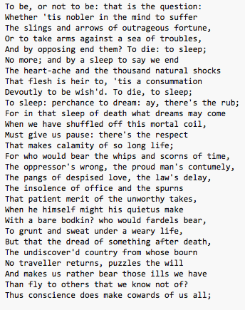
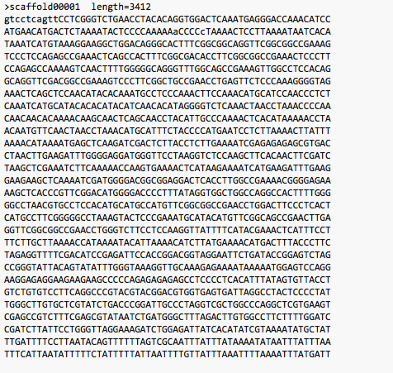
Demo1

Slide 37
Demo1
awk '{print}' test.txt
awk '{print $1}' test.txt
awk '{print $10}' test.txt
awk '/the/{print NR}' test.txt
awk '/the|The/{print NR}' test.txt
awk '/the/{c=c+1}END{print c}' test.txt
awk '/GATCGATC/{c=c+1}END{print c}' sequence.fa
awk '/>/{c=c+1}END{print c}' sequence.fa
awk '/>/{getline; if ($0~/AAAA/) c=c+1}END{print c}' sequence.fa

Slide 38
Demo 2
Using Homo_sapiens.GRCh38.86.chr.gtf

Slide 39
Demo 2
Print all lines that include a specific identifier
awk '/MITF/{print}' Homo_sapiens.GRCh38.86.chr.gtf
Print all the genes in a given chromosome and strand, as tab-delimited
awk '{OFS="\t"; if ($1== "22" && $7=="+" && $3=="gene") print}' Homo_sapiens.GRCh38.86.chr.gtf
Print their genome coordinates
awk '{OFS="\t"; if ($1== "22" && $7=="+" && $3=="gene") print$1, $4, $5, $7, $9) }' Homo_sapiens.GRCh38.86.chr.gtf
Count known exons for MITF gene
awk '/MITF/{OFS="\t"; if ($3=="exon") c=c+1}END{print c}' Homo_sapiens.GRCh38.86.chr.gtf

Slide 40
Extras
Other useful functions:
split
awk '/scaffold12946/{split($9,a,";"); print a[2]}' Mesculenta_147_gene.gff3
getline
awk '/>/{getline; if ($0~/AAAA/) c=c+1}END{print c}' Mesculenta_147.fa
many others

Slide 41

Extras
One-liners:
    http://www.pement.org/awk/awk1line.txt
    http://nixshell.wordpress.com/2009/04/01/awk-one-liners/
Manuals
    http://www.gnu.org/software/gawk/manual/gawk.html
    http://www.grymoire.com/Unix/Awk.html
    http://pubs.opengroup.org/onlinepubs/7908799/xcu/awk.html

Slide 42

Genomic formats…

