Slide 1

High Performance Computing for genomic applications
Basics of shell scripting with bash – and related useful tricks
Scientific IT Services
Michal Okoniewski

Slide 2
Bash – general information
Bash is a command and scripting language of the Unix shell
Bash commands are executed from the command prompt or a script
In the cluster queueing system, bash scripts are typically wrapping several commands and are sent for execution
  Here we learn bash to use it with LSF to send jobs on the cluster
Unix (incl. Liunx) and macOS systems “speak bash” as a native command language

Slide 3
How to work with bash
Edit the script file, with “#!/bin/bash” on top
Save it as *.sh
Add the execution permissions
  chmod a+x my_test.sh
  chmod 755 my_test.sh
Run it as
  ./my_test.sh
  . my_test.sh
  source my_test.sh

Slide 4
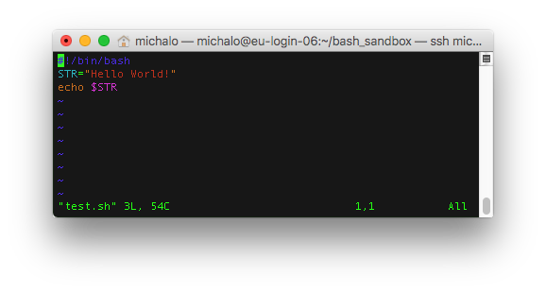
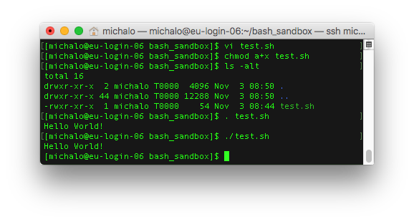
Hello world example

Slide 5
Useful bash language constructs
Variables
  Setting name="mutant1.fastq.gz"
  Calling: $name or ${name}
Loops
  for … do … done
Conditional execution
  if … then … else … fi

Slide 6
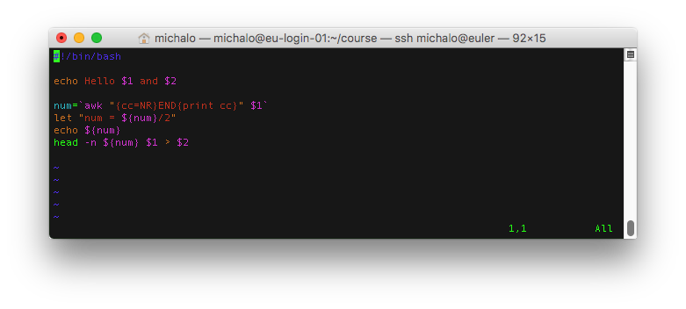
Parameters in the script

Slide 7
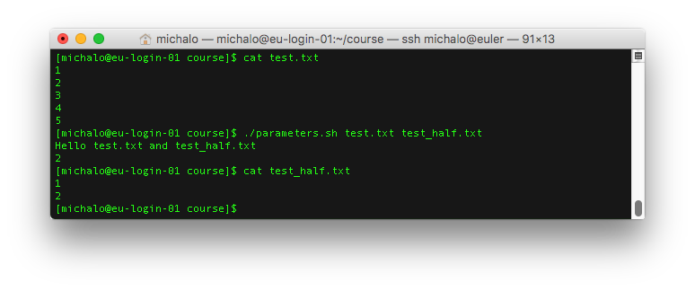
Parameters in the script - result

Slide 8
Useful bash language constructs
  Environment variables
    echo $PATH
    echo $SCRATCH
Can be set globally in .bash_profile or .bashrc, eg:
    INCLUDE=$INCLUDE:$HOME/genomics/samtools-1.3.1:$HOME/genomics/samtools-1.3.1/lib:$HOME/genomics/samtools-1.3.1/bam

Slide 9
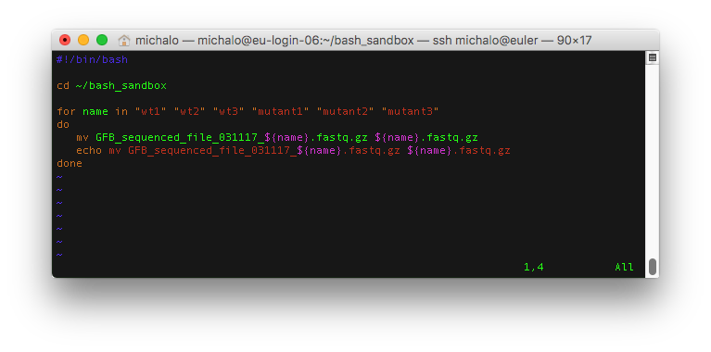
Bash can be used to do automatization of (boring) tasks

Slide 10
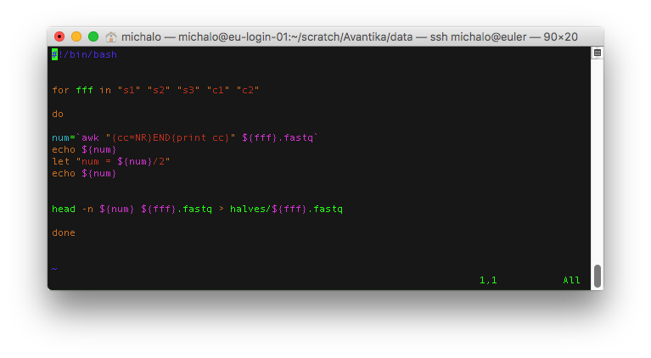
Yet another example

Slide 11
Bash testing advice
In the script, make sure where it is executed, eg start with
  cd /cluster/home/michalo/ME9
Development runs and testing of the bash scripts
  On the login nodes only if they are not using heavy or multithreaded computations
  Otherwise: in the interactive session on the compute node
  Scripts that do not use heavy computing, but take long time, eg. slow downloads – can be run in a “screen” command sessions
For tracing and debugging use echo command in critical steps of the script

Slide 12

Bash…
Questions?

