Slide 1
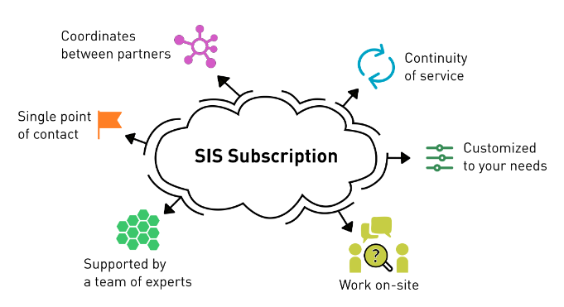
Scientific IT Services subscription for D-BIOL
D-BIOL has a subscription on the work of Scientific IT Services ETH
It includes in pre-paid mode various type of work for the labs
Consulting
Data analysis support
Training
Software development
The service owners is Thomas Wüst, on D-BIOL side Patrick Pedrioli.

Slide 2
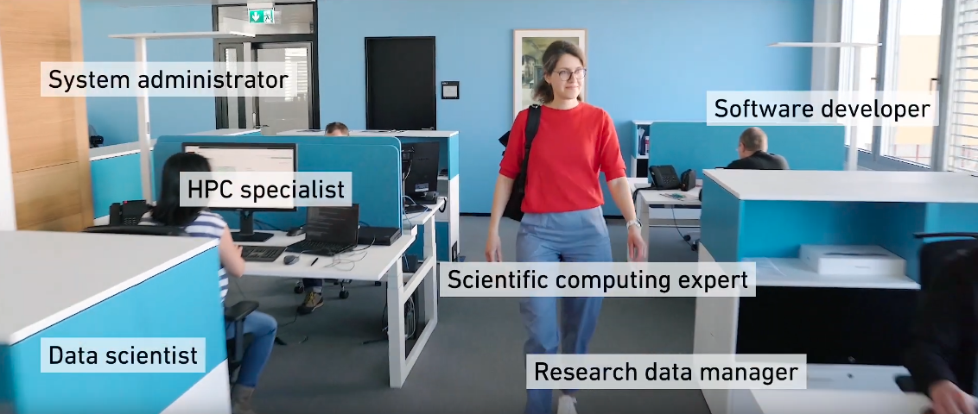
Scientific IT Services subscription for D-BIOL
SIS is located in Octavo building in Oerlikon
The SIS experts can be contacted directly or via service channels

Slide 3
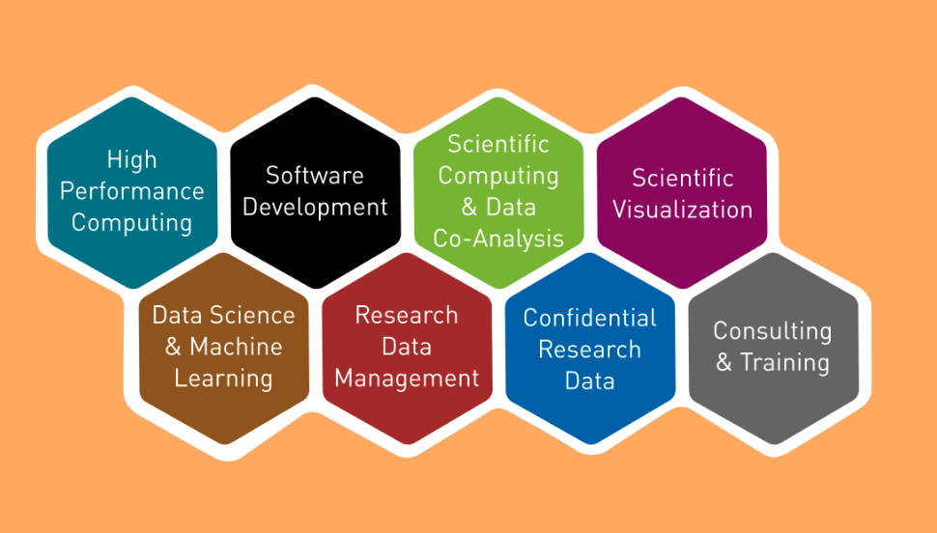
Types of support
Machine learning service
Bioinformatics co-analysis service
Code clinics
Scientific Data Management
openBIS
Cluster support for Euler and secure LeonhardMed clusters
Courses
Individual consulting
Service-based and collaborative projects

Slide 4
Scientific IT Services: 4 groups
Research Platforms
High Performance
Computing
Software
development
Computational and Data Science Support

Slide 5
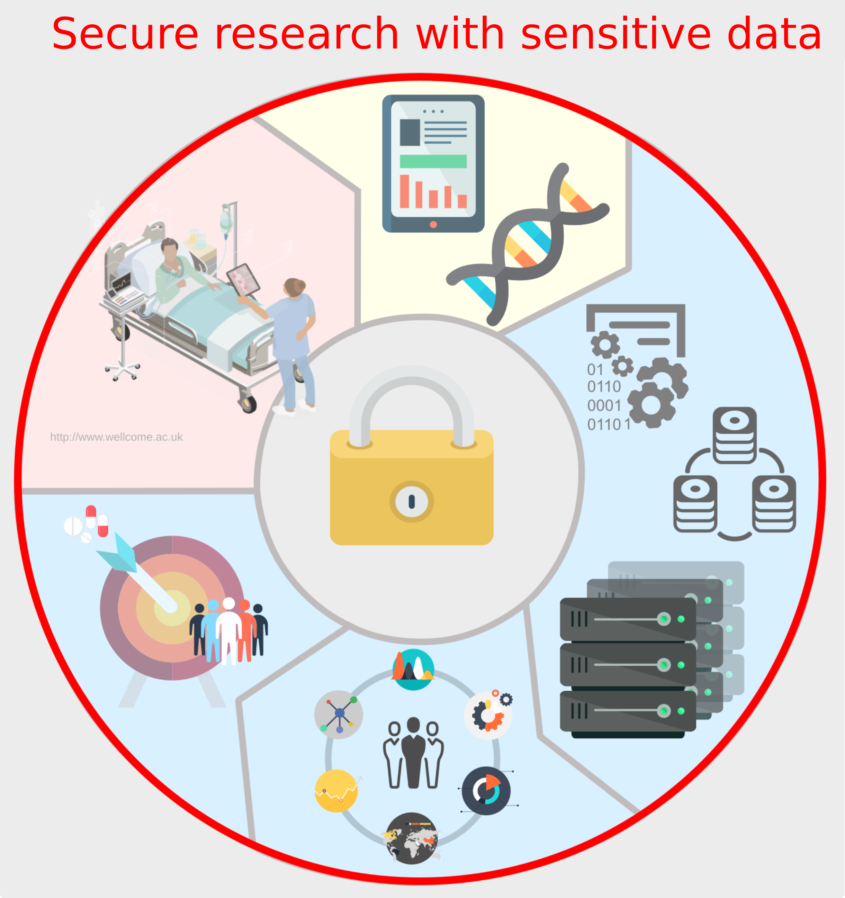
Scientific IT Services
Research Platforms
24.06.2024
5

Slide 6
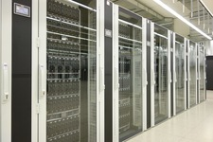
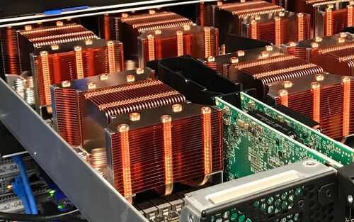
Scientific IT Services
Scientific computing
EULER cluster
High Performance
Computing

Slide 7
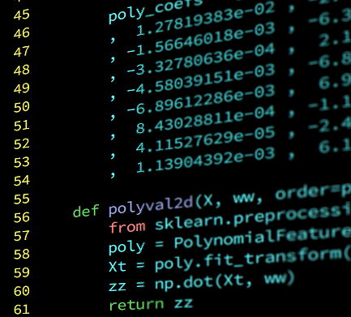
Scientific IT Services
Software
development
openBIS development
Custom software development
Scientific visualizations
Scientific code support

Slide 8
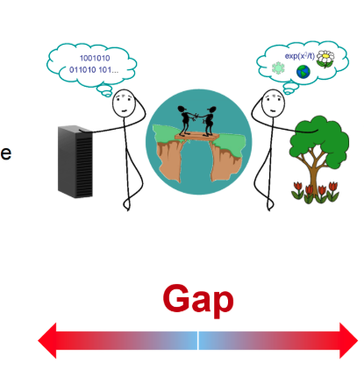
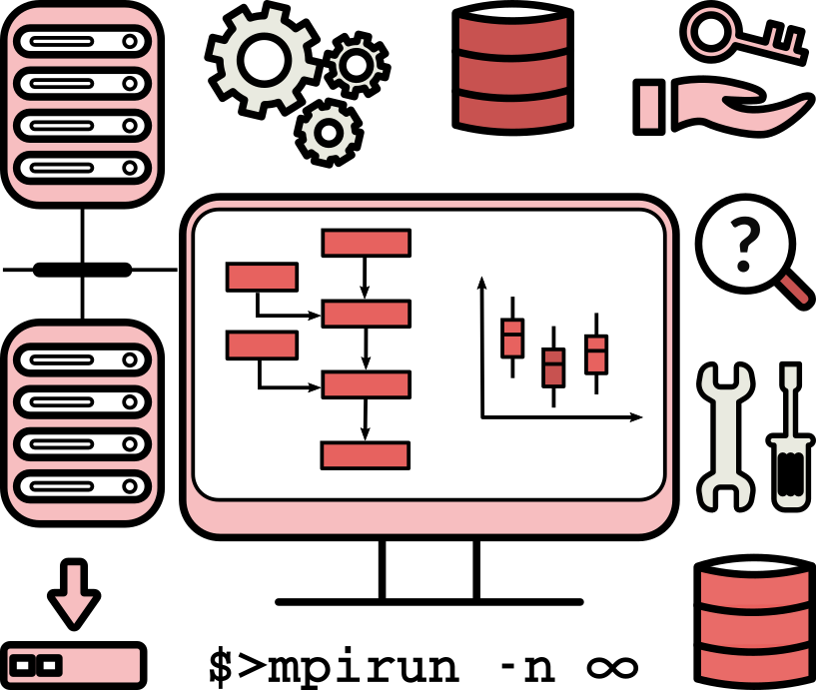
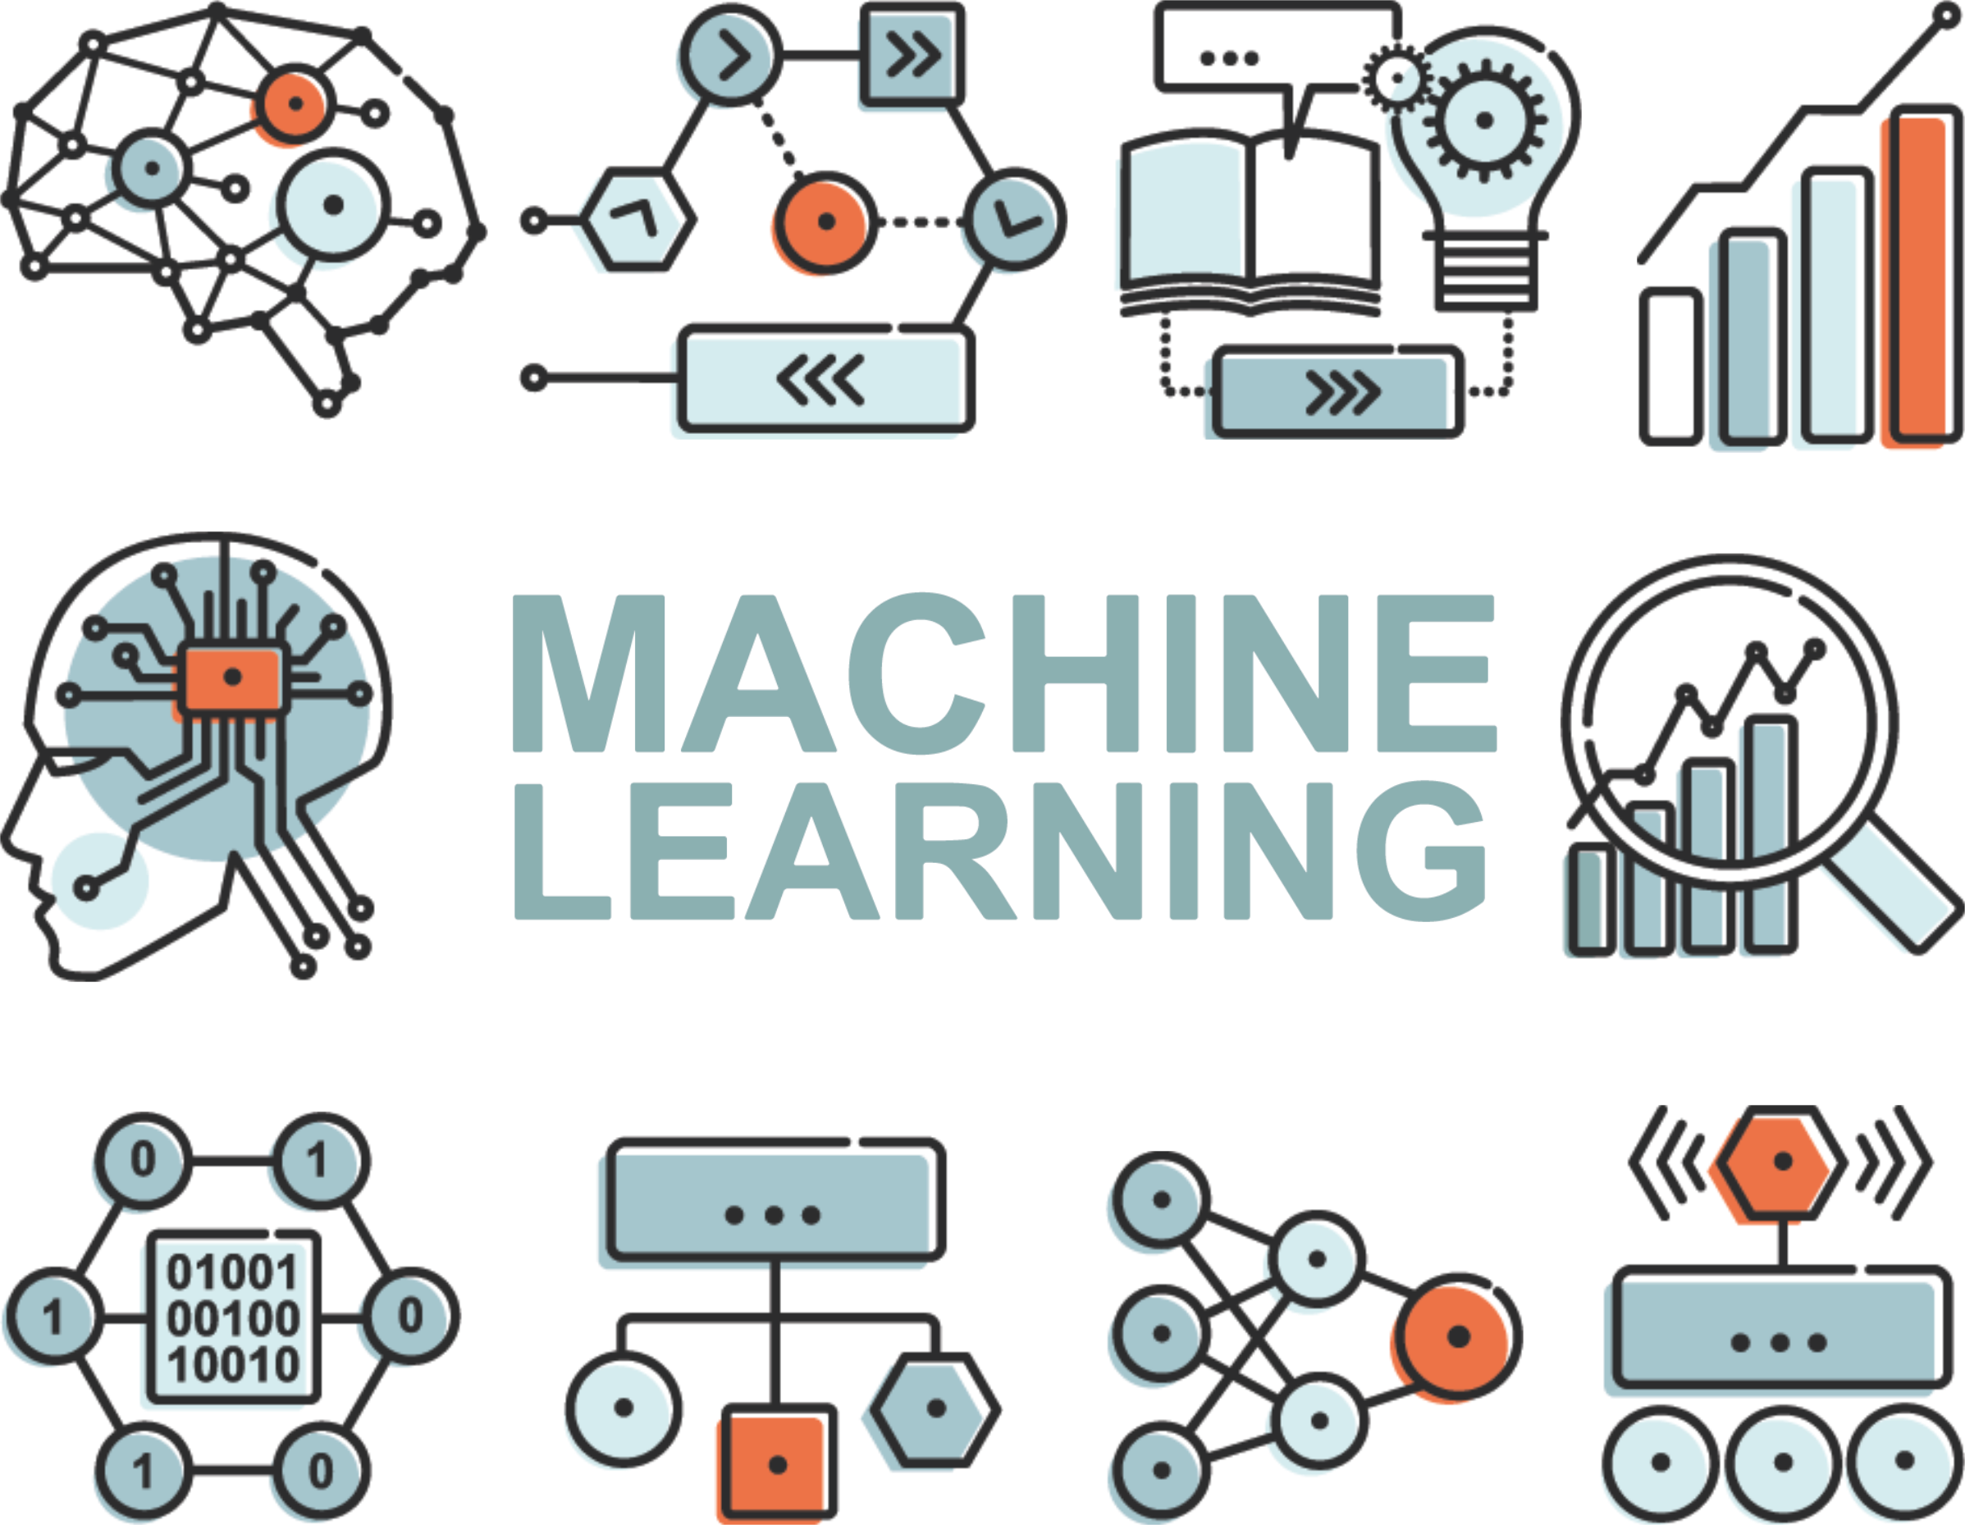
Scientific IT Services
Computational and Data Science Support
Scientific IT consulting
“Glue” between the SIS units
Data science
Data co-analysis
Machine Learning/ AI

Slide 9
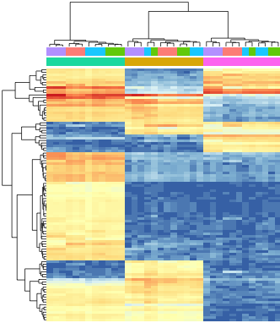
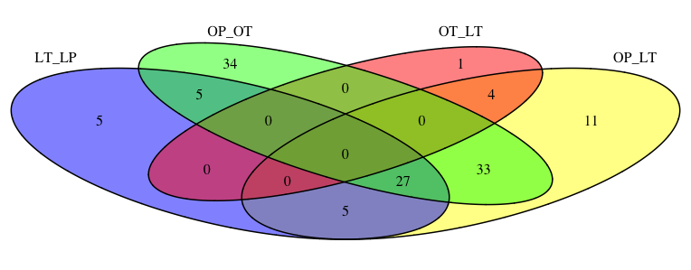
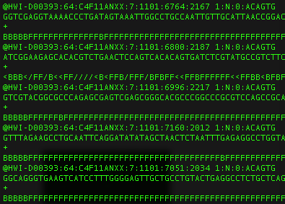
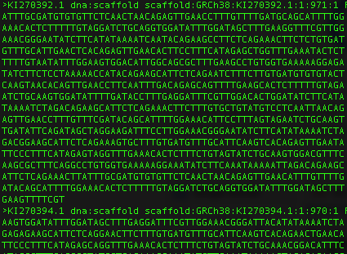
Bioinformatics consulting
publications
sequencing facilities
results
Research
sequencing data
data analysis
researcher
co-analysis
SIS bioinformatics
consultant
High performance computing clusters
genomes and databases
bioinformatic software

Slide 10
Types of courses
High Performance Computing for –omics
Advanced HPC with Snakemake
Fast Python
Machine Learning
Introduction to openBIS
Research Data Management
MPI
See also https://sis.id.ethz.ch/services/index.html#consulting-training

