Slide 1

High Performance Computing for genomic applications
Using genomic software on Euler
Scientific IT Services
Michal Okoniewski

Slide 2
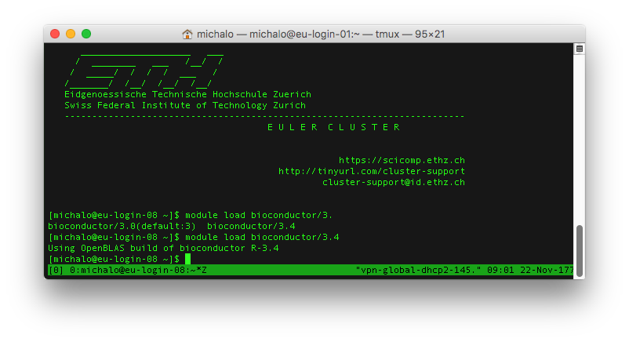
Bioinformatic modules on EULER
module load
module load gdc
module avail
module purge
module spider
See
  https://scicomp.ethz.ch/wiki/Euler_applications_and_libraries_ubuntu

Slide 3
Bioinformatic software jungle - categories
Trimming tools: trimmomatic, cutadapt
Aligners:
  General purpose: bwa, bowtie, SHRiMP
  RNA aligners: STAR, tophat, subjunc, hisat2
  Transcriptome aligners: kallistio, salmon, sailfish, RSEM
  Other aligners: Blast, Blat, VMATCH
De-novo assemblers: trinity, velvet, spades
Feature extraction, counting: HTSeq, featureCount
  Transcript discovery: cufflinks,
Specialized tools
Utilities and conversion tools: samtools, bcftools, bedtools, picard tools

Slide 4
Bioinformatic software jungle, RNAseq as seen 7 years ago
Alignment
to the genome
Genomic feature
extraction
- counting
Statistical
analysis
tools
Functional analysis
tools
STARTING
PANEL
Options
For analysis
Mode:
Step-by-step
Single-run
Experiment
definition
David
genome
String DB
GTF/GFF
RPKM
tables
SparkSeq
tests
REPORTING PANEL
Selection of
graphs
Report types
output formats (BED CSV..)
Setting thresholds
Functional analysis parametres
igenomes
ht_seq
RPKM
tables
GeneGo
(commercial)
Count table
DESeq/edgeR
fastq
BAM
Count tables
(gene, exon…)
SparkSeq
counts
Ingenuity
(commercial)
fastq
STAR
aligner
BAM
DEXSeq
fastq
Filters,
trimming
BAM
Filters,
trimming
SparkSeq
junctions
junctions
Reporting
fastq
BAM
junctions
Differential expression
report
tophat
aligner
junctions
MISO/MATS
unmapped
BAM
junctions
Differential splicing
report
fastqc
unmapped
BAM
jsplice
unmapped fastq
Output
unmapped
fastq
cufflinks/
cuffdiff
BED
Genome
browser
Genome
browser
CSV
Genome
browser
Fastqc report
other
fastq
RSEM/Bitseq
isoform
deconvolute

Slide 5
Trimming tools
trimmomatic, cutadapt
Trimming:
  Removing adapters
  By quality: eg sliding window
  Fixed position, eg several base pairs at each end
Typicaly: fastq on input, fastq on output
  itets more complex with paired reads

Slide 6
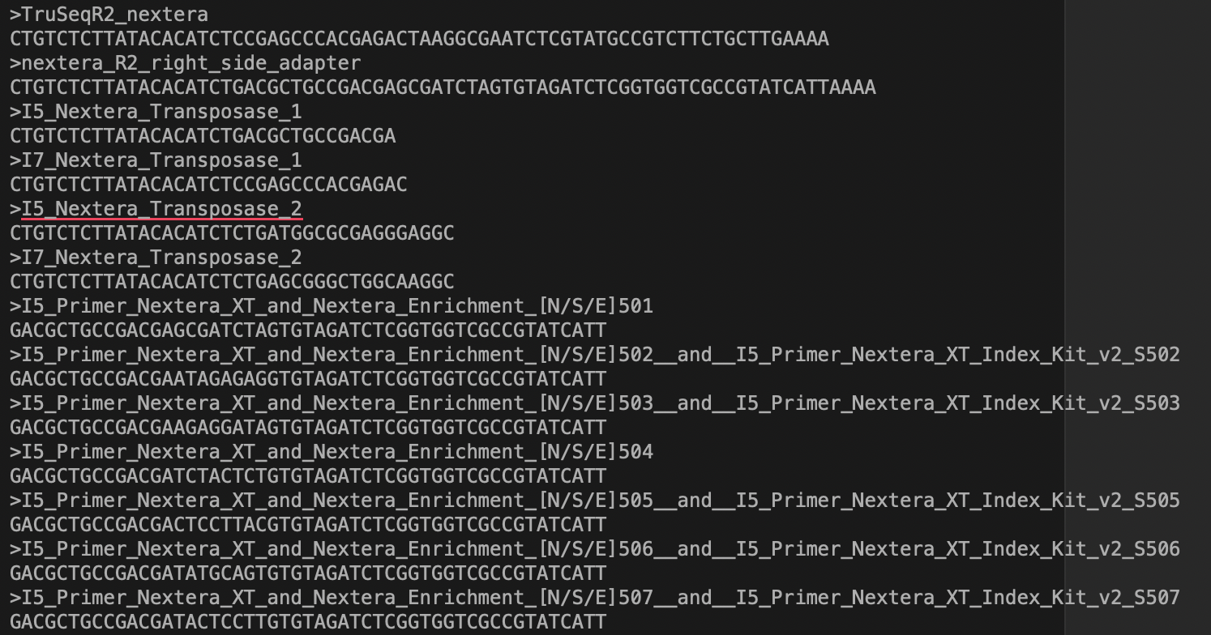
Trimming tools
module load gdc
module load java
module load trimmomatic
trimmomatic SE {input} {output} ILLUMINACLIP:adapters.fa:2:30:10 LEADING:3 TRAILING:3 SLIDINGWINDOW:4:15 MINLEN:36

Slide 7

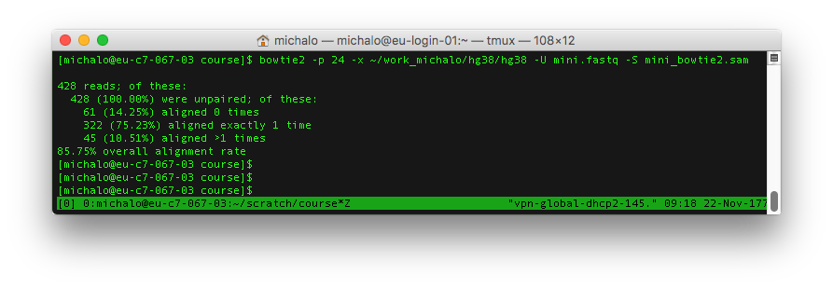
Bowtie, bowtie2
Building genome index
bowtie2-build --threads 24 /cluster/home/michalo/work_michalo/hg38/Homo_sapiens.GRCh38.dna.primary_assembly.fa /cluster/scratch/michalo/hg38/hg38
Alignment:

Slide 8
Tophat
Classic splice-aware aligner
Uses bowtie2 as engine, so also bowtie2 index
tophat -p 24 -o tophat_out --library-type fr-firststrand ~/work_michalo/hg38/hg38 mini.fastq.gz
Manual: http://ccb.jhu.edu/software/tophat/index.shtml

Slide 9
Splice aware aligners for RNA-seq, memory needs
 | Index type | Index size=memory needs for hg38 | Computing node
Tophat, 2011 | bowtie index in a file | in a file | any
STAR, 2014 | In memory | ca 40GB | EULER normal (65G)
Subjunc, 2014 | In memory | ca 40GB | EULER normal (65G)
Hisat2, 2016 | In memory | ca 7GB | good laptop (>=8G RAM)

Slide 10
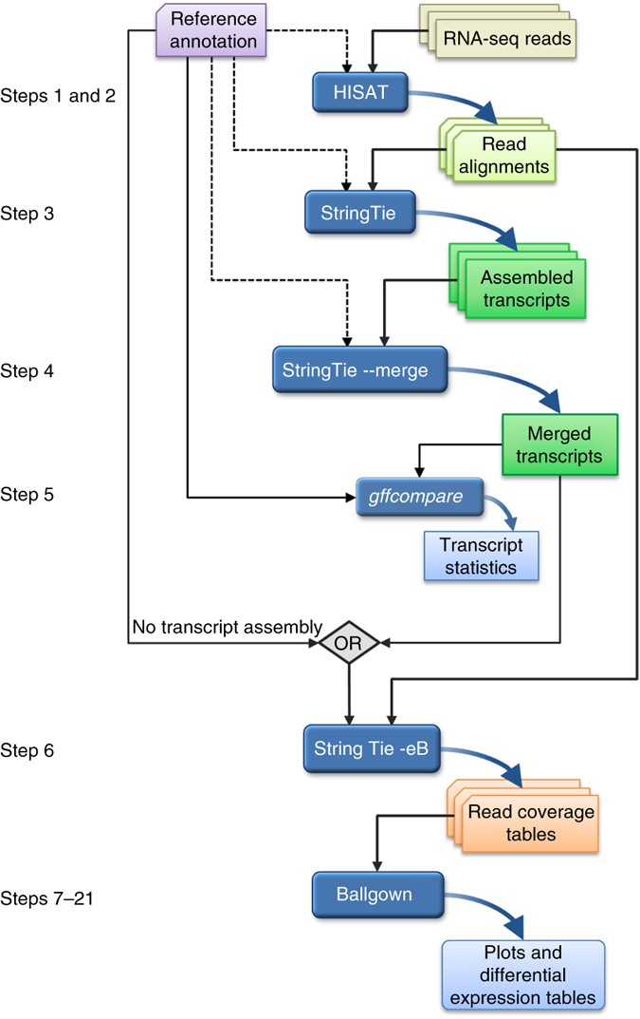
Tuxedo suite and “new tuxedo”

Slide 11
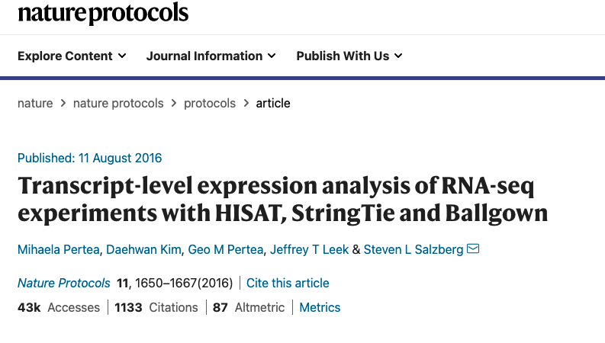
“New tuxedo suite”

Slide 12
Cufflinks and stringtie
Transcript discovery tools
Uses coverage and junctions from a BAM file
cufflinks mini_star.sorted.bam
Other
  cuffmerge, cuffdiff, cuffquant, cuffnorm, CummeRbund

Slide 13
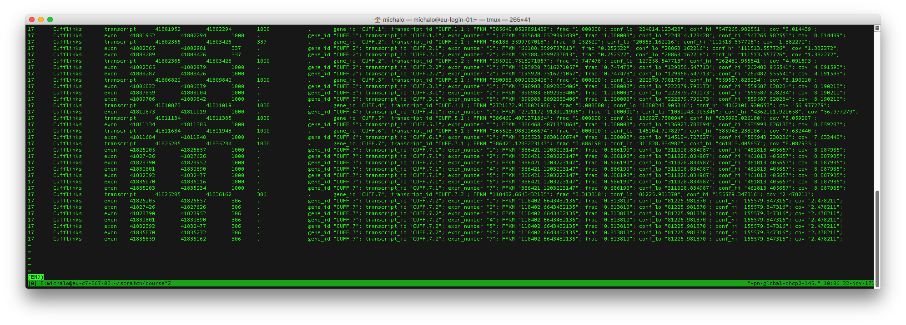
Cufflinks and stringtie
Produces GTF

Slide 14
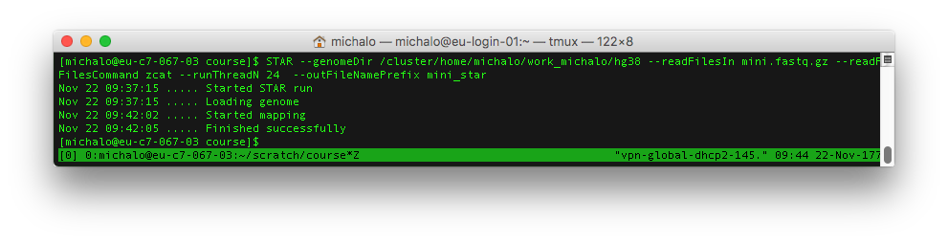
STAR
Splice aware aligner, loading index into memory
Results similar to tophat, but faster
--genomeLoad LoadAndKeep
With specific options, can produce BAM and do the counting too
https://github.com/alexdobin/STAR/blob/master/doc/STARmanual.pdf

Slide 15
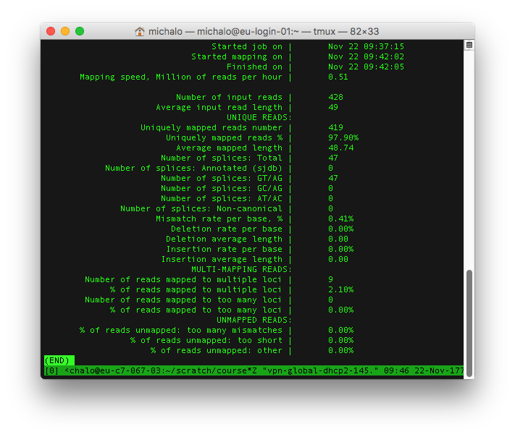
STAR statistics

Slide 16
subread
Includes subjunc similar to STAR and featureCounts
Building index
subread-buildindex -o /cluster/home/michalo/work_michalo/hg38/subread_index/hg38 /cluster/home/michalo/work_michalo/hg38/Homo_sapiens.GRCh38.dna.primary_assembly.fa
Alignment
subread -T 24 -i /cluster/home/michalo/work_michalo/hg38/subread_index/hg38 -r mini.fastq -o mapped_reads_subjunc/mini.bam
subjunc -T 24 -i /cluster/home/michalo/work_michalo/hg38/subread_index/hg38 -r mini.fastq -o mapped_reads_subjunc/mini.bam
http://bioinf.wehi.edu.au/subread-package/SubreadUsersGuide.pdf

Slide 17
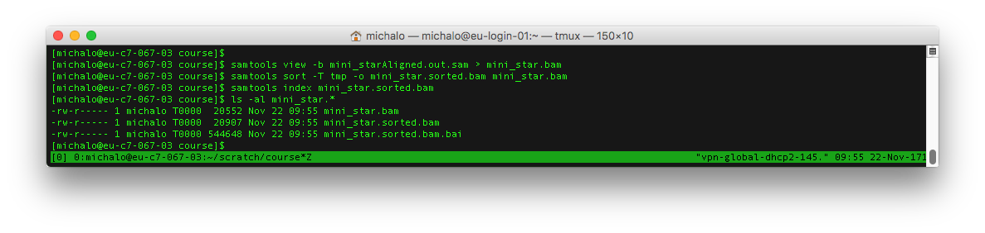
samtools
General purpose tool for conversion of BAM ⬄ SAM
Many other operations: pileup…
See: http://www.htslib.org/doc/samtools.html

Slide 18
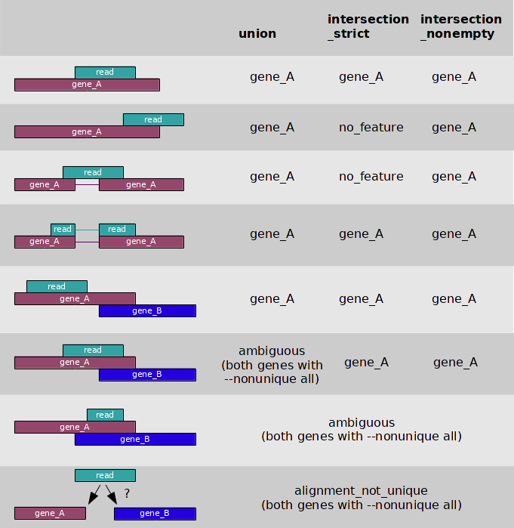
Counting reads in genes is non-trivial!
htSeq counting modes
by Simon Anders

Slide 19
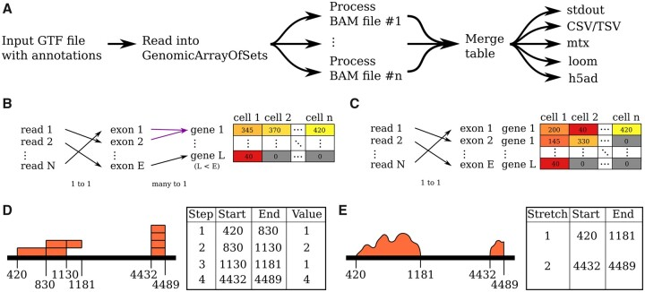
HTSeq 2.0

Slide 20
featureCounts
Fast and flexible counting in genomic features
featureCounts -M -s 2 -T 24 -t gene -g gene_id -a /cluster/home/michalo/work_michalo/hg38/Homo_sapiens.GRCh38.86.chr.gtf -o mini.cnt mini_star.sorted.bam

Slide 21
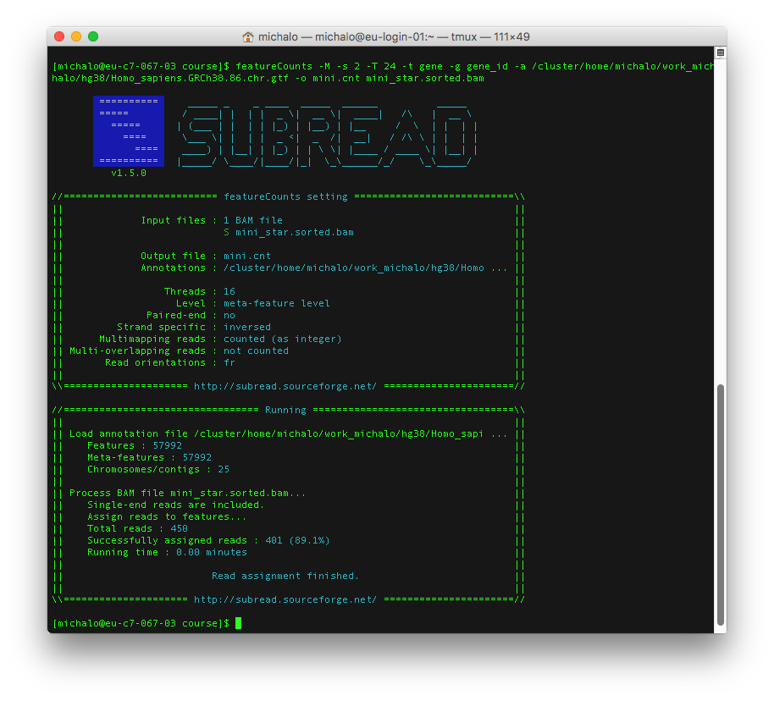
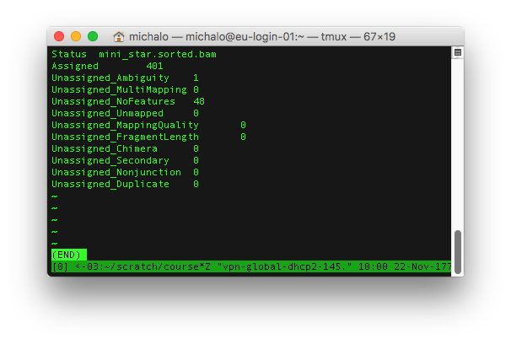
featureCounts

Slide 22
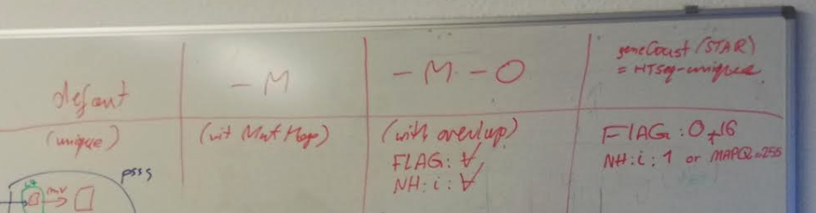
Tuning featureCounts
Defaults counting features can be fuound in current STAR
Still, for many cases a more careful counting is needed
Gene or exon level counting
Options

Slide 23
SRA tools
The command line download of public datasets from Short Read Archive
http://ncbi.github.io/sra-tools/
fastq-dump
fastq-dump --split-files ERR2811092
(from v2.9) fasterq-dump --split-files ERR2811092 –e 4

Slide 24

Bedtools
“swiss army knife” for BED, GFF, SAM/BAM, VCF
Conversion
Annotation
Getting sequences
Genomic ranges
….

Slide 25
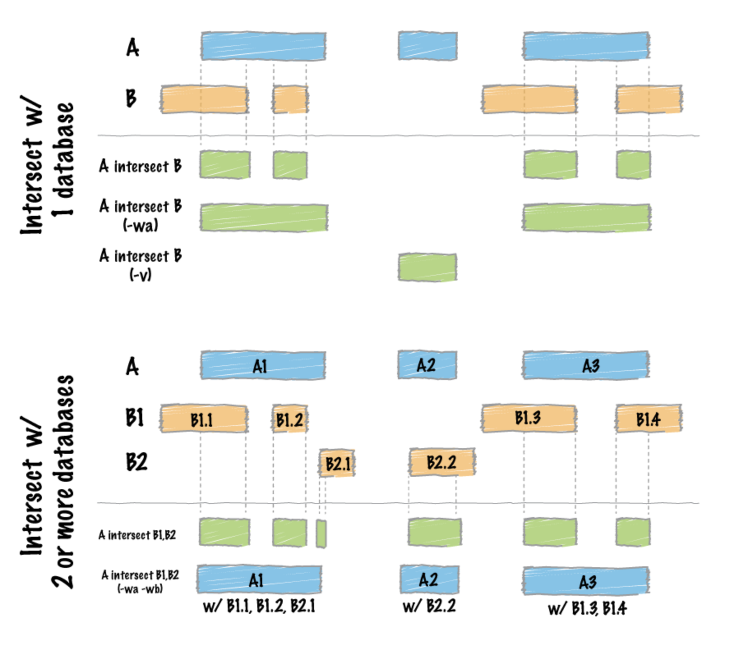
Bedtools - intersect

Slide 26
GATK
GATK is a genomic toolbox for various operations related mainly to genomic variants calling
Operations include producing a variant file *.vcf from an alignment file *.bam
module load gcc/4.8.2 gdc java/1.8.0_73
gatk/3.5java -jar GenomeAnalysisTK.jar -T UnifiedGenotyper -R ref/human_g1k_b37_20.fasta -I bams/exp_design/NA12878_wgs_20.bam -o sandbox/NA12878_wgs_20_UG_calls.vcf -glm BOTH -L 20:10,000,000-10,200,000
https://software.broadinstitute.org/gatk/documentation/tooldocs/current/
https://software.broadinstitute.org/gatk/documentation/topic?name=tutorials
http://gatkforums.broadinstitute.org/gatk/discussion/7869/howto-discover-variants-with-gatk-a-gatk-workshop-tutorial

Slide 27
Resources needed by bioinformatic tools on EULER
 |  | cores | memory node | time/queue
Trimming | Trimmomatic, cutadapt | 1 |  | 24h
Aligners - old | bowtie, bwa, SHRiMP, tophat | many: 24 |  | 4h
Aligners - RNAseq | STAR, subread | many: 24 | 65G | 4h
Aligners - optimized | hisat2 | many: 24 |  | 4h
Conversion tools | Samtools, bcftools | 1 |  | 4h
Counting | featureCount | 1 |  | 4h
De-novo assembly | Spades, velvet | many | 256GB-1T | 24h or more
Variant calling | GATK, pileup | many | 256GB | 24h
…

Slide 28
Alternative software stacks
Self-managed conda software stack
Singlarity containers software stack: Galaxy/Biocontainers
Mulled containers
Other software combos

Slide 29
Building own conda-based software stack
Python becomes increasingly popular
Conda is the package manager for python-based software
It takes care of dependencies, installs other packages needed

Slide 30
Building own conda-based software stack - example
Create and activate a new environment:
conda create --name phylophlan
conda activate phylophlan
once inside the environment you can add your conda installation steps, eg.
conda install -c bioconda phylophlan
Conda creates loads of small files. Thus using /cluster/project (NetApp storage) is recommended. User directory may not be a good place for conda, due to quota limitations!

Slide 31
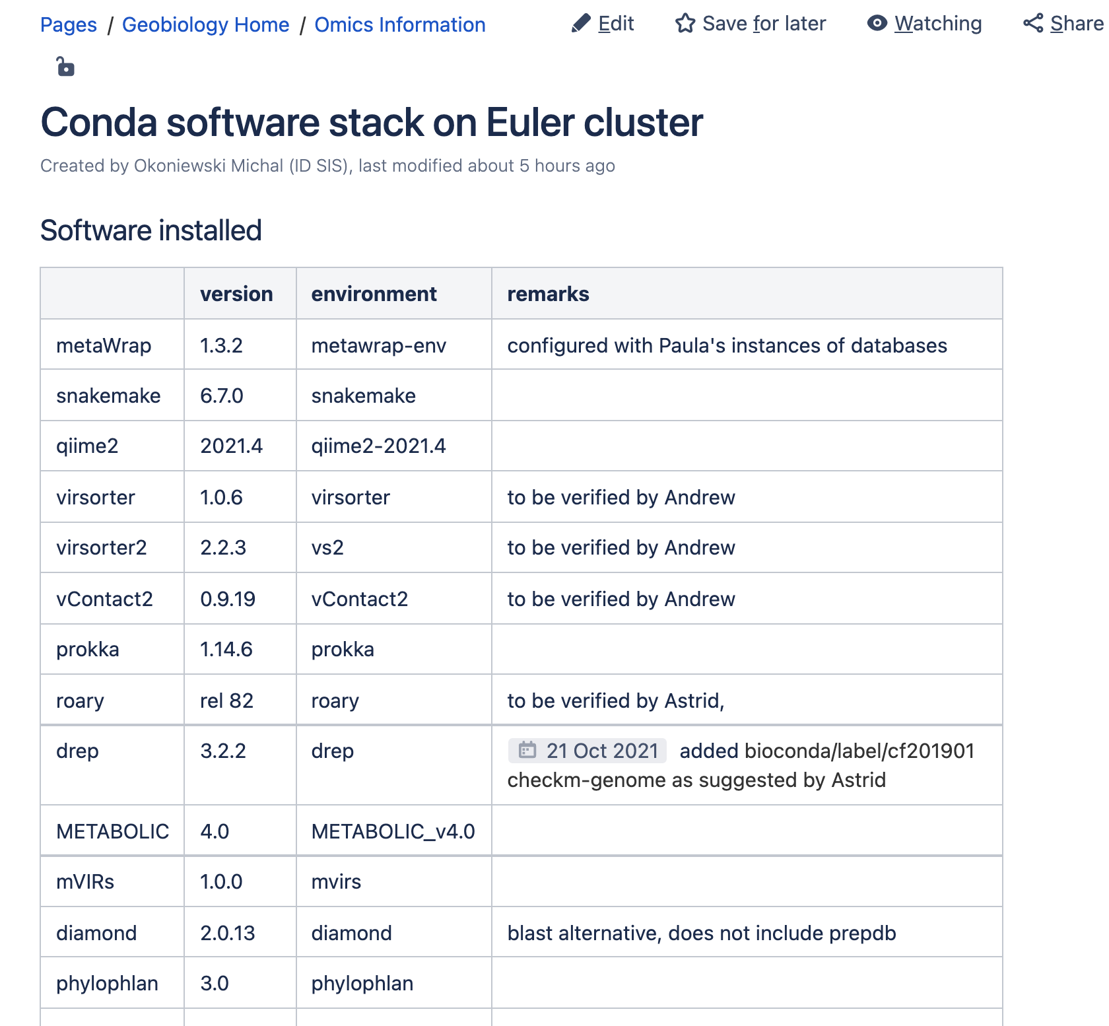
Building own conda-based software stack - example
More on software in
conda and containers
in the advanced course…!

Slide 32
Software stacks - Singularity containers from Galaxy Depot
97’000 containers for bioinformatic software
  various versions
  optimized for size, runnable state, faster download
  https://depot.galaxyproject.org/singularity/
  converted from docker-based Biocontainers
    docker containers not allowed on the cluster for security reasons
Snakemake does caching the containers in the workflow internals (.snakemake)
  Downloaded only once
https://scicomp.ethz.ch/wiki/Galaxy_Depot_Software_Stack
Notes:
There is no {input} and {output} in the python – and that’s OK as long as proper files are produced.

Slide 33
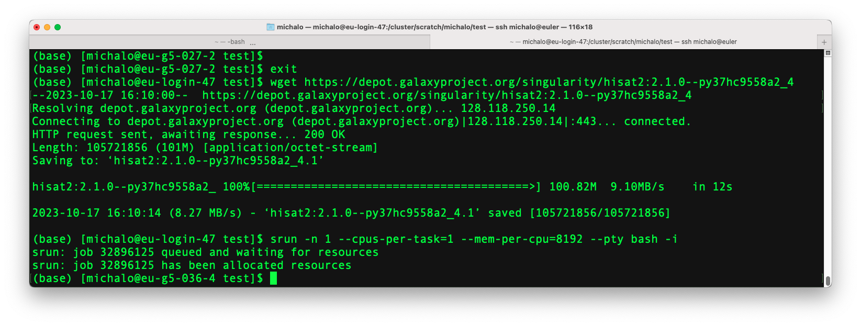
How to use a single container on the cluster?

Slide 34
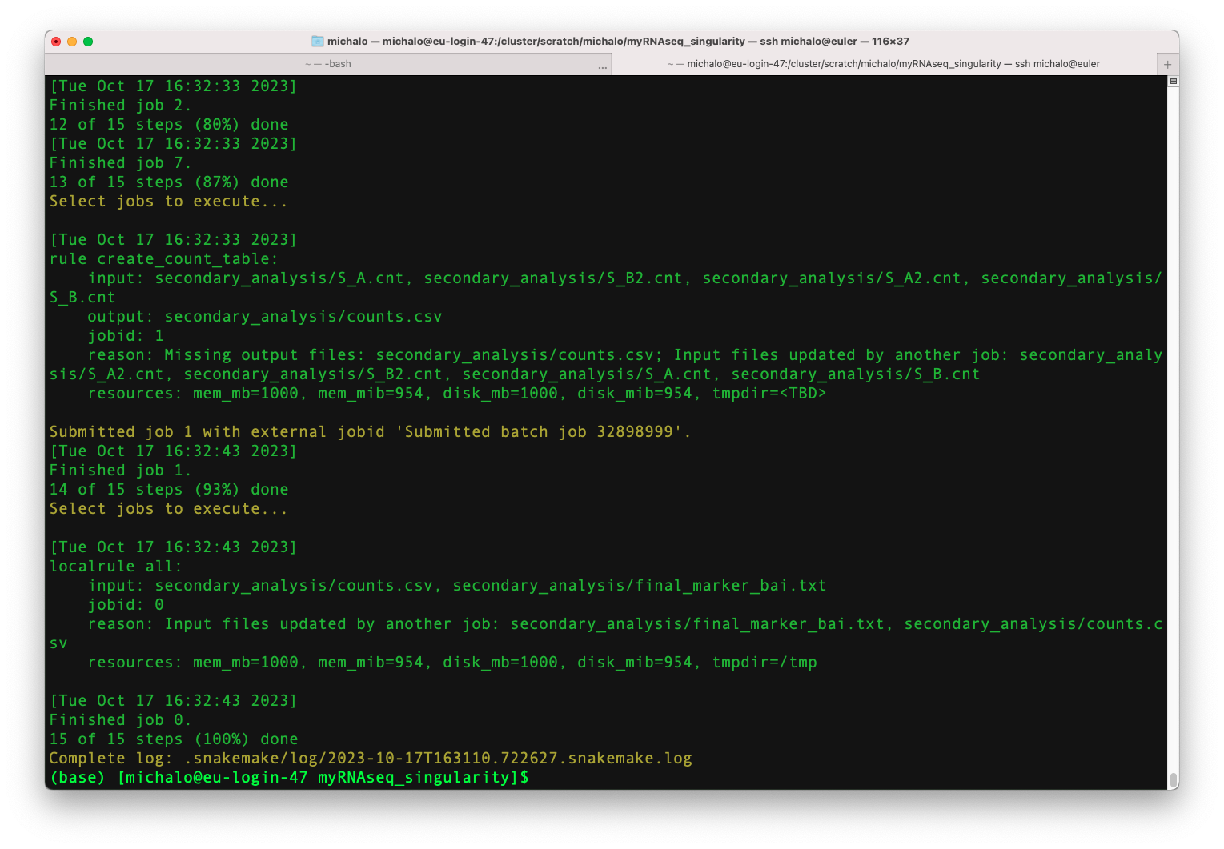
More on alternative software stacks…
In the “advanced” ie. Snakemake-focused, advanced part of the course!

Slide 35
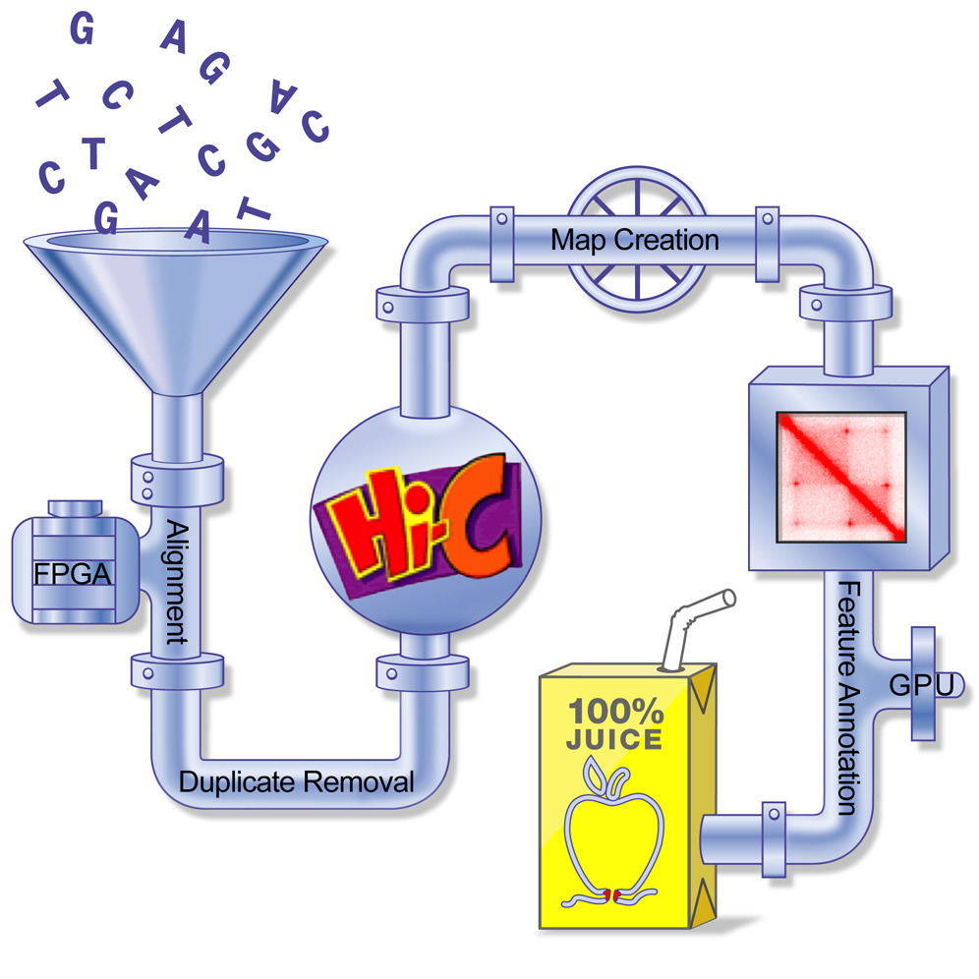
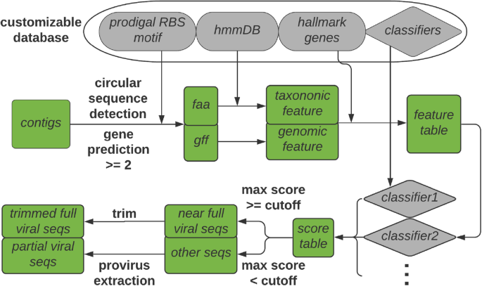
Bioinformatic software “combos”
Examples:
  virsorter, vContact2 in metagenomics
  Juicer in HiC-seq
A tool having an internal workflow of many tools, in python, bash, snakemake.
Often not tuned for the cluster use:
  Complex internally. Sometimes generating many separate cluster jobs. Sometimes not.
  Usage patterns mixing 1-core intput-output and multicore heavy computing
  Not tested in HPC or slurm queueing system
  Hidden software dependencies
  Needs additional databases
Ask me or cluster-support@id.ethz.ch

Slide 36

Using genomic software on Euler
Thank you!

