Slide 1
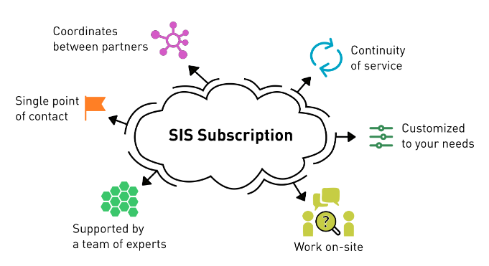
Scientific IT Services subscription for D-BSSE
D-BSSE has a subscription on the work of Scientific IT Services ETH
It includes in pre-paid mode various type of work for the labs
Consulting
Data analysis support
Training
Software development
The service owners is Matt Baker.

Slide 2
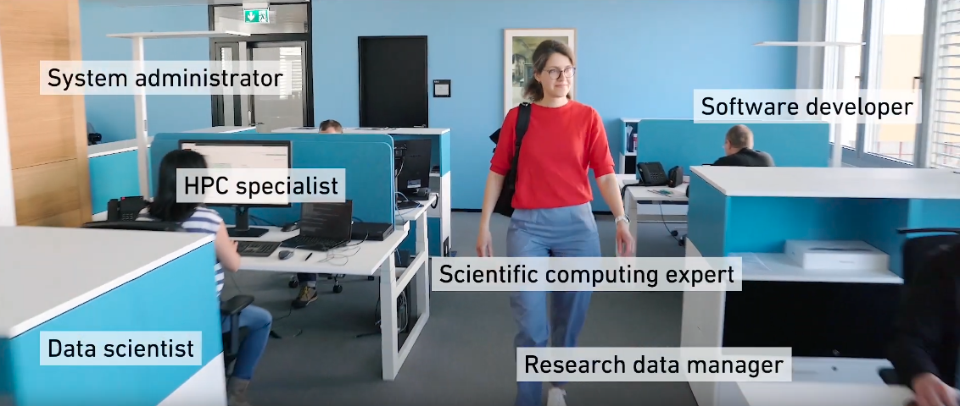
Scientific IT Services subscription for D-BSSE
SIS is present in the BSS building
Also the experts from Zurich can be contacted directly or via service channels

Slide 3
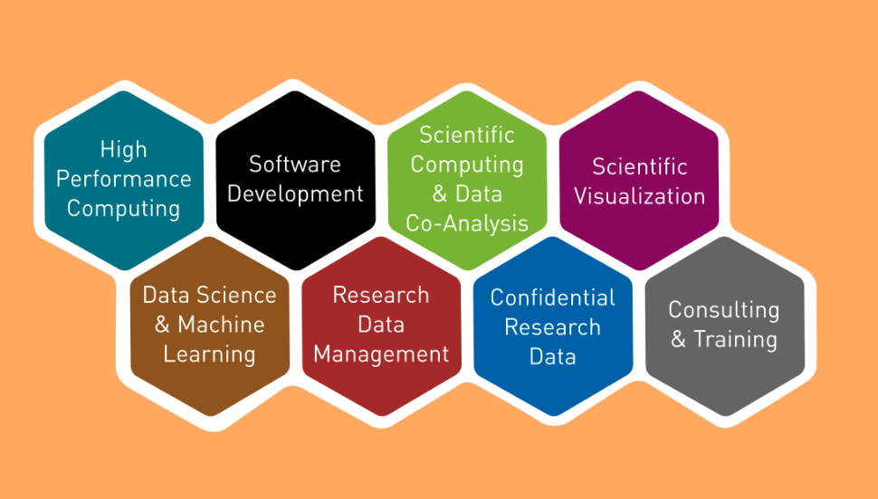
Types of support
Machine learning service
Bioinformatics co-analysis service
Code clinics
Scientific Data Management
openBIS
Cluster support for Euler and secure LeonhardMed clusters
Courses
Individual consulting
Service-based and collaborative projects

Slide 4
Types of courses
High Performance Computing for –omics
Advanced HPC with Snakemake
Fast Python
Machine Learning
Introduction to openBIS
Research Data Management
MPI
See also https://sis.id.ethz.ch/services/index.html#consulting-training

