Slide 1

Welcome to the course:
High Performance Computing for genomic applications
- basic
Scientific IT Services
Michal Okoniewski, Samuel Fux, Nadia Marounina

Slide 2
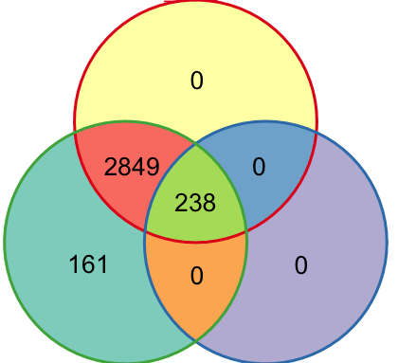
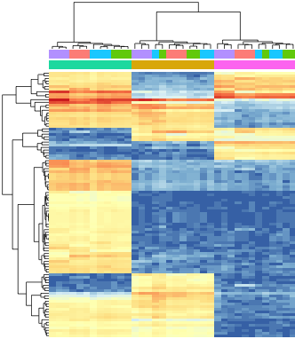

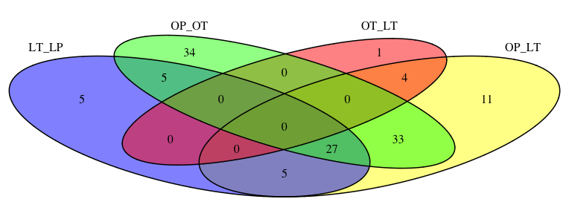
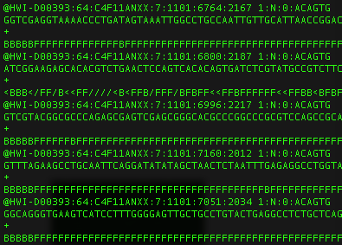

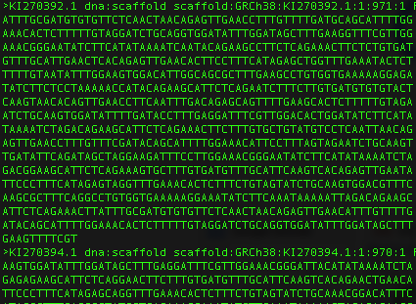
Genomic data analysis and co-analysis
publications
sequencing facilities
results
Research
sequencing data
data analysis
researcher
co-analysis
SIS bioinformatics
consultant
High performance computing clusters
genomes and databases
bioinformatic software

Slide 3
Co-analysis principles
data analysis
co-analysis
SIS team is here to help you!
The purpose is decided by the researcher
The researcher can learn as much as wants/needs
IT tasks can be outsourced to SIS or done together if possible
An upper SIS workload limit is set at the start
SIS bioinformatician
consultant
researcher

Slide 4
Example projects in co-analysis mode
Making long-term computing tasks parallel on the computing cluster
Code profiling and optimization (R, python, bash…)
RNA-seq analysis - or other genomic/proteomic data)
Reproducible analysis workflows, eg. snakemake
Non-typical analysis, eg. alternative splicing
Making 3-rd party software or code run
Database and data management consultancy
Help with genomic repositories:
  Upload and publishing of own data
  Analysis of public data

Slide 5

High Performance Computing for genomic applications - basic https://siscourses.ethz.ch/hpc_genomics_2023dbiol_basic/
Let’s start!

