Slide 1

High Performance Computing for genomic applications
Analysing genomic data from public repositories
Scientific IT Services
Michal Okoniewski

Slide 2
Reproducible research
Repositories for public genomic data: GEO, SRA, EGA
  Depositing the data required for publication
  Downloaded data not guaranteed to be in a specific format
Reproducible workflows: snakemake
Code repositories: github
Containerization: docker
Despite the recent progress in reproducibility, still a lot of bioinformatic expertise, data cleaning and custom coding/scripting is needed

Slide 3
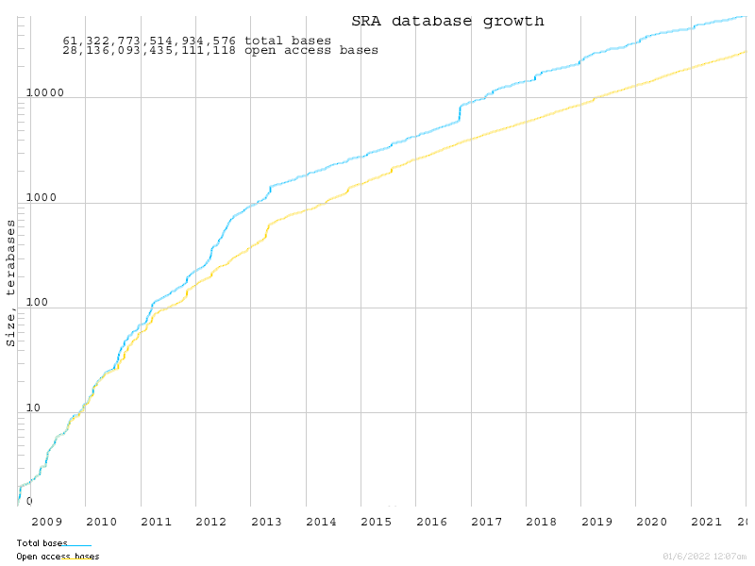
SRA database growth

Slide 4
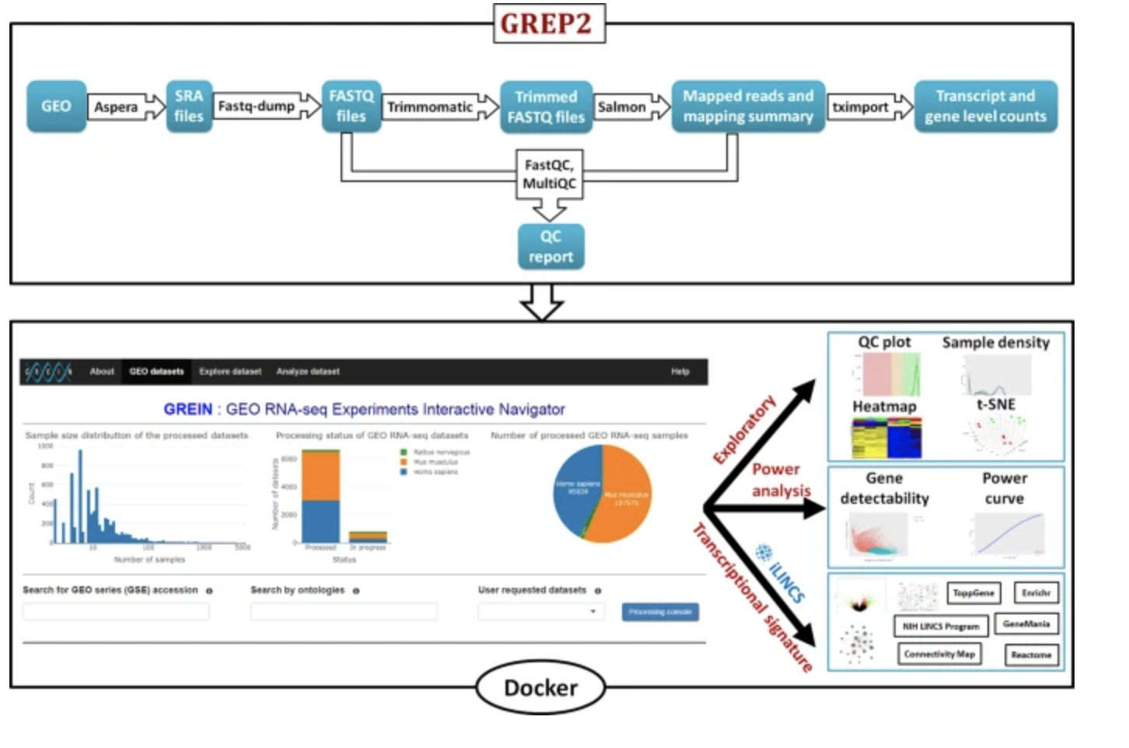
Web-based analysis tools for public RNA-seq: GREIN

Slide 5
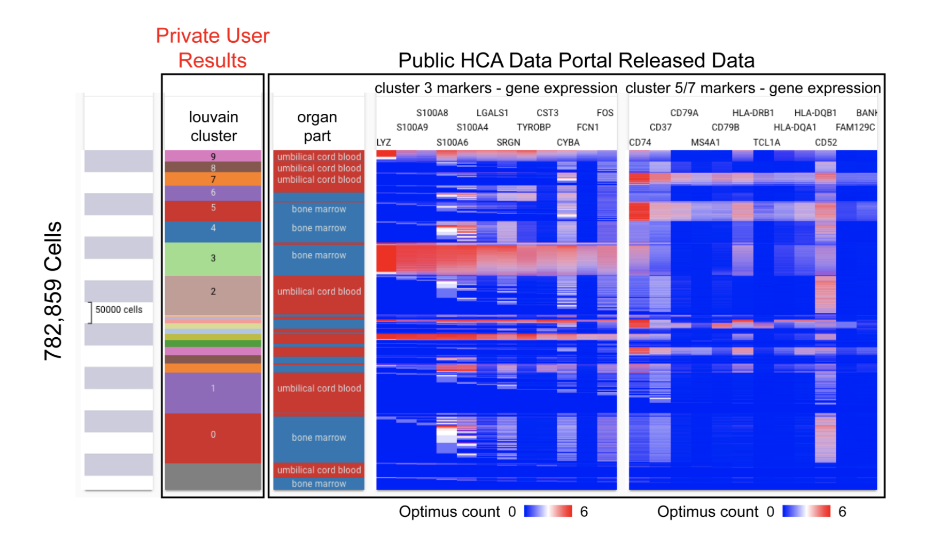
Web-based analysis tools for public RNA-seq: UCSC Xena

Slide 6
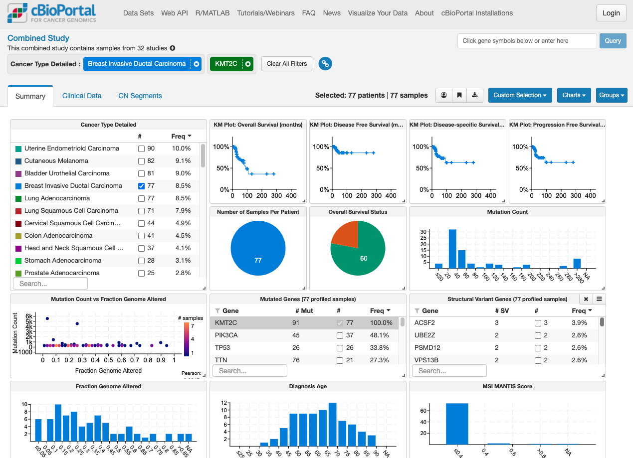
Web-based analysis tools: cBioPortal, TCGA and related databases

Slide 7
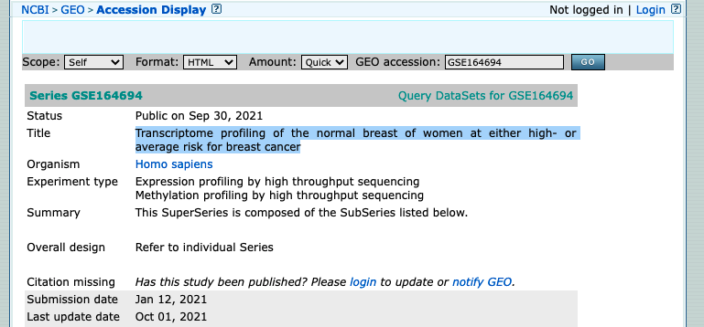
Use case 1: Breast cancer genome signatures
Question: verify cell line results of expression with real patients
Breast cancer
Study to compare: GSE164694 “Transcriptome profiling of the normal breast of women at either high- or average risk for breast cancer”
187 samples with DNA and RNA sequenced

Slide 8
Use case 1: Breast cancer genome signatures
K106845_RNASeq | K106863_RNASeq (second donation from K106169)
GSM5016108 | GSM5016109
Public on Sep 30 2021 | Public on Sep 30 2021
Jan 12 2021 | Jan 12 2021
Sep 30 2021 | Sep 30 2021
SRA | SRA
1 | 1
Breast | Breast
Homo sapiens | Homo sapiens
age: 71 | age: 37
age of menarche: 15 | age of menarche: 13
menopausal status: Post | menopausal status: Pre
brca1: No | brca1: No
brca2: No | brca2: No
blood relatives cancer: No | blood relatives cancer: No
race: WHITE | race: WHITE
hispanic: No | hispanic: No
bmi: 23.4 | bmi: 32.8
ever pregnant: Yes | ever pregnant: No
life time risk (tyrer-cuzick score): 2.30% | life time risk (tyrer-cuzick score): 13.80%
Good aspects:
  Many samples
  Good clinical decription: age, BMI, BRCA markers,…
  Recent study, done on Illumina HiSeq 4000
    good sequencing quality
Depending on analysis needs:
  No raw data, just counts per gene per sample
Harder aspects
  Clinical data need cleaning, not „database quality”

Slide 9
Use case 1: Re-analysis plan
Combine the expression files into a count table
Clean the clinical metadata
Get the interesting variables from the metadata
Get the list of relevant genes from the researcher
Create the subset of expression: genes of interest in clinically relevant samples
Plot the heatmap of it

Slide 10
Use case 1: Re-analysis plan
Combine the expression files into a count table (R, 30 lines)
Clean the clinical metadata (text editor)
Get the interesting variables from the metadata (R, 20 lines)
Get the list of relevant genes from the researchers (BioMart conversions)
Create the subset of expression: genes of interest in clinically relevant samples (R, 20 lines)
Plot the heatmap of it (R, 20 lines)
Discussion
Iterate the 4 points above, until the researcher is happy

Slide 11
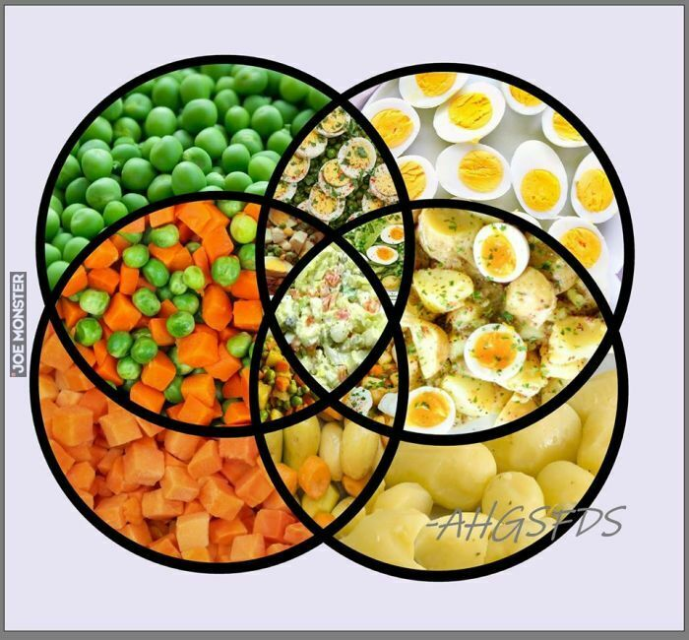
Use case 1: Outcome

Slide 12
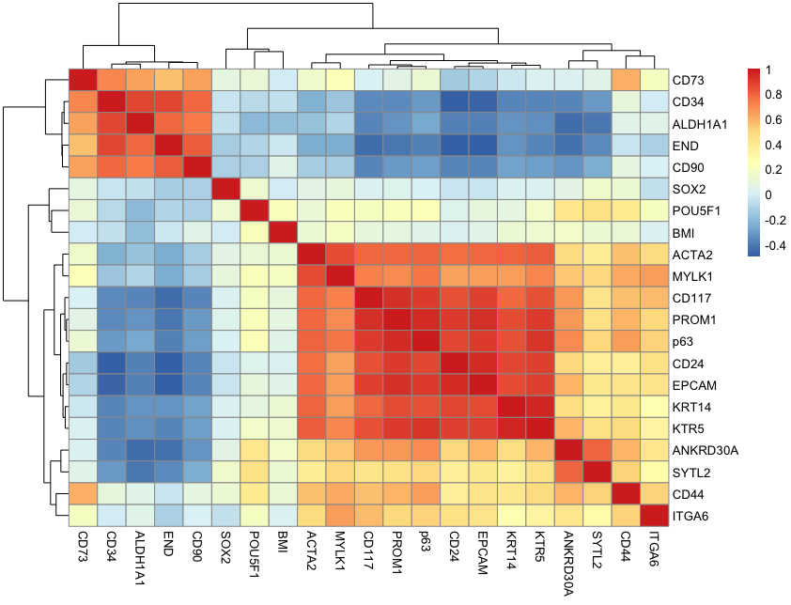
Use case 1: Outcome

Slide 13
Use case 1: Outcome
Workload
  PI, bioinformatician, 3 PhD students (mostly learning)
  Discussions: 5h, data preparation: 5h
  R coding and experimenting: 4 days, ca 300 lines of code
  Total time start-finish: 2 months, usualy no hackaton mode, the knowledge needs “incubation”
Lessons learned:
  No primary analysis needed: saved us a bit of bioinformatic work, no cluster use
  Xena on other study helped with data preparation, but heatmaps in R were more controllable
  Tested several versions of genomic signatures
    they were proving what was expected
    Some new knowledge

Slide 14
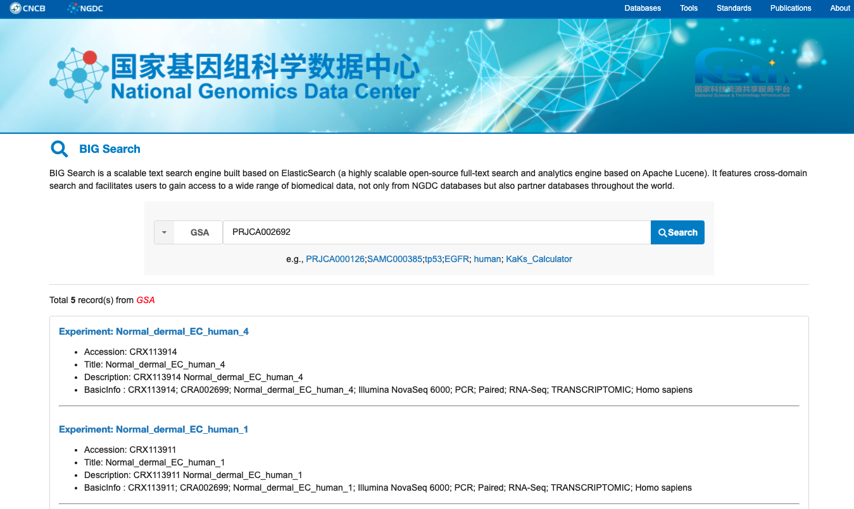
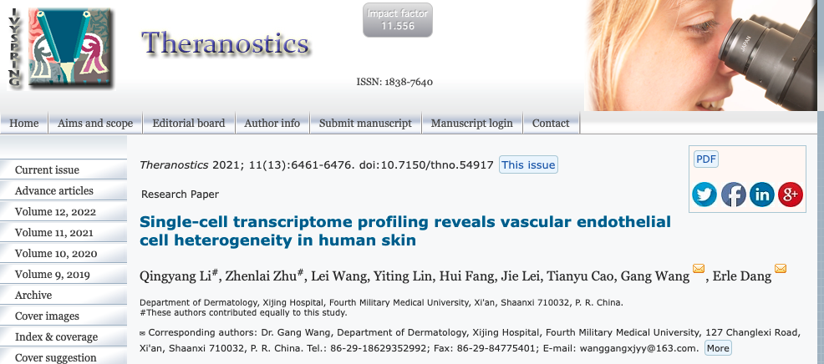
Use case 2: Single-cell RNAseq, dermal endothelial cell atlas
Need to access and repeat the analyses on raw data
Published in NGDC (National Genomic Data Center) in China
  counterpart of SRA

Slide 15
Use case 2: Re-analysis plan
Get the data from the repository
  Tricky, takes time and patience. 4 archive files of 8-40 GB
Transfer the data to Euler scratch, unarchive
Run cellranger count in Euler job
Re-format the outcome into a standard count table: genes x samples
Get the data format for 10x t-SNE and visualize
Analyze the selected cells expression with selected/tuned statistical tests
Enable in-depth local checks for custom genomic signatures

Slide 16
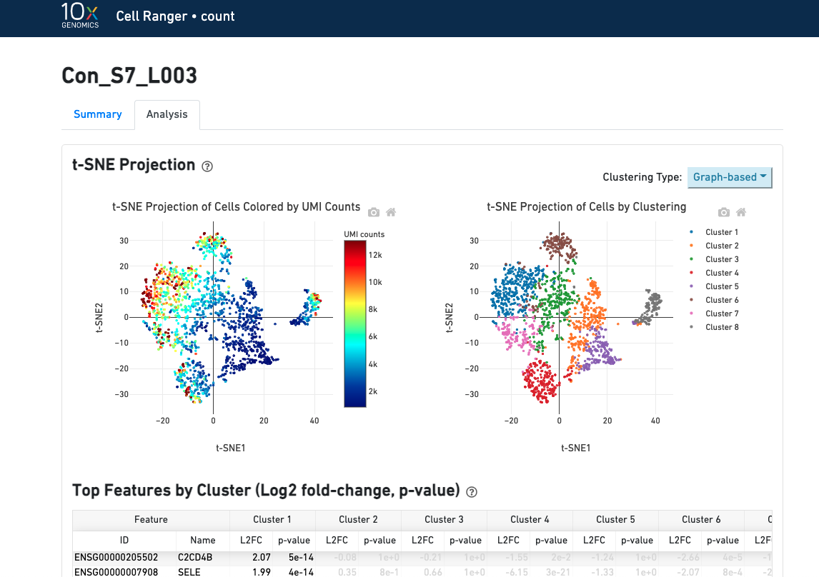
Use case 2: cellranger on Euler
cellranger count --id=Con_S7_L003 \
--fastqs=. \
--sample=Con \
--transcriptome=/cluster/home/michalo/project_michalo/genomics/refdata-gex-GRCh38-2020-A \
--localcores 8
Analyses to be continued…

Slide 17
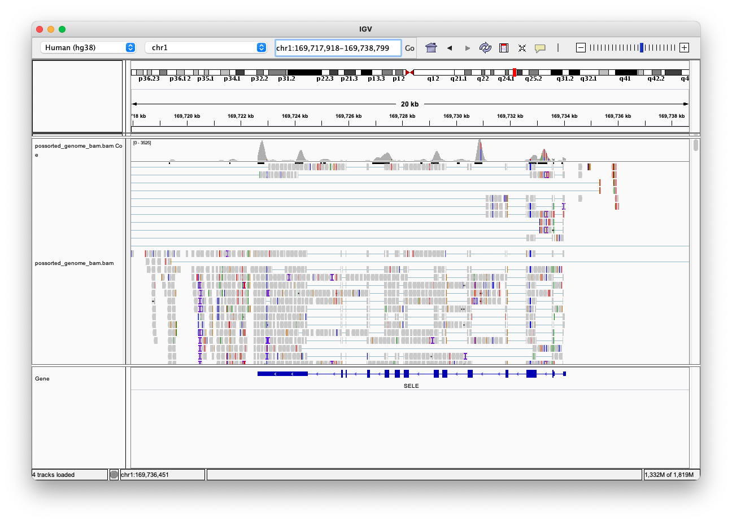
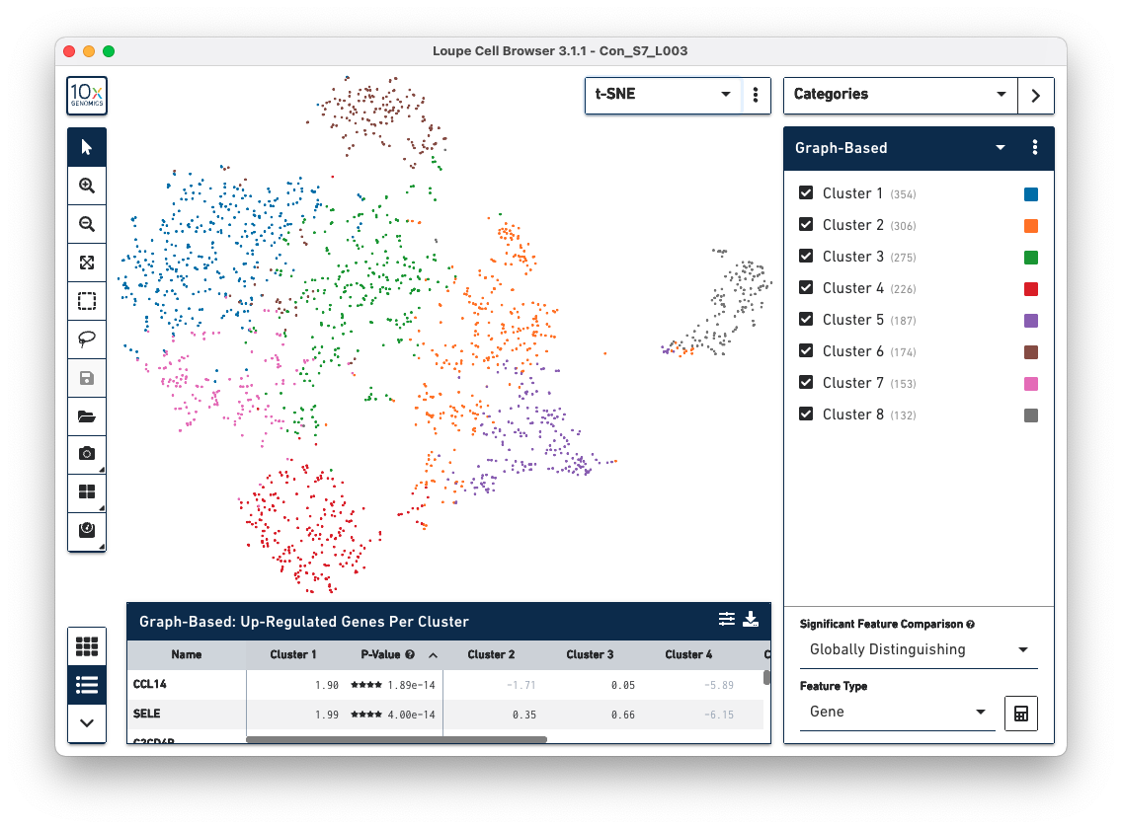
Use case 2: outcome: alignment and t-SNE in Loupe

Slide 18
Use case comparison of re-analyses
Cancer clinical signatures on RNA-seq
Preprocessed data, no primary analysis needed
Data size: ca 200MB of counts
No cluster processing needed
Main tools: R
Outcome: custom heatmaps
Workload: ca 1 week (of all collaborating)
With data from Xena: 2 hours
Single cell RNA-seq atlas re-analysis
Big, raw data available, need for full primary analysis
Data size 100GB (500x more)
Euler needed for primary analysis
Main tools: cellranger, samtools, R, text editors
Outcome: t-SNE, custom heatmaps, custom statistical tests
Workload: 2 weeks (??)

Slide 19
Re-analysis, summary
It is worth checking if a similar experiment has been sequenced
It is worth learning the analysis process, as you may have similar data in the lab
Use the shortcuts (aligned data, Xena-like online browsers) if you can
If you need cluster processing
  It will take more work and time
  Most often the reproducibility will not be perfect. Primary analysis is hard to repeat exactly.
Check the options and strategy with a bioinformatician
Think of creating a semi-automated pipeline of data re-analysis for your lab

Slide 20

Analysing genomic data from public repositories
Enjoy

