Slide 1

High Performance Computing for genomic applications
Snakemake example with genomic data
Scientific IT Services
Michal Okoniewski

Slide 2



Orchestration strategies: workflow managers
tool A
tool B
raw.txt
intermediate.txt
result.txt
result.txt
Snakemake
a Python workflow manager

Slide 3
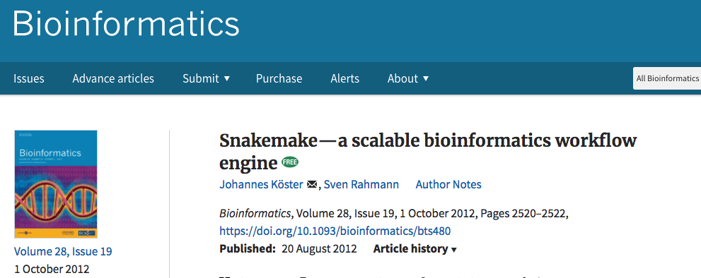

Snakemake
Workflow management system
Designed by Johannes Köster
  Now PI at UniEssen
Python3 – based
cmake philosophy
conda installation
conda support
http://snakemake.readthedocs.io/

Slide 4
Installation
Install miniconda
  Download and run the installer (eg. Miniconda3-latest-Linux-x86_64.sh)
Install snakemake with conda
  conda install -c bioconda -c conda-forge snakemake
  conda install -c bioconda -c conda-forge snakemake-minimal
Test
  snakemake --version

Slide 5
Parsing the workflow
rule_all defines the final product
Snakemake parses searches for files needed to do this final products
Then, recursively, searches for what needs to be done for the “substrates”
After successful parsing (in syntax and content):
Workflow is started from the “substrates” of lowest level
Proceeds as DAG (directed acyclic graph) towards the final product

Slide 6
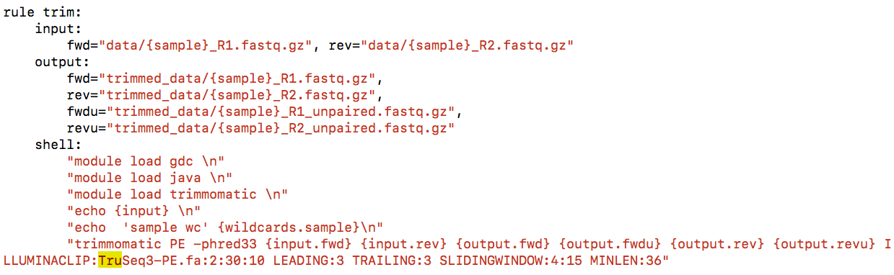
Snakefile – rules

Slide 7
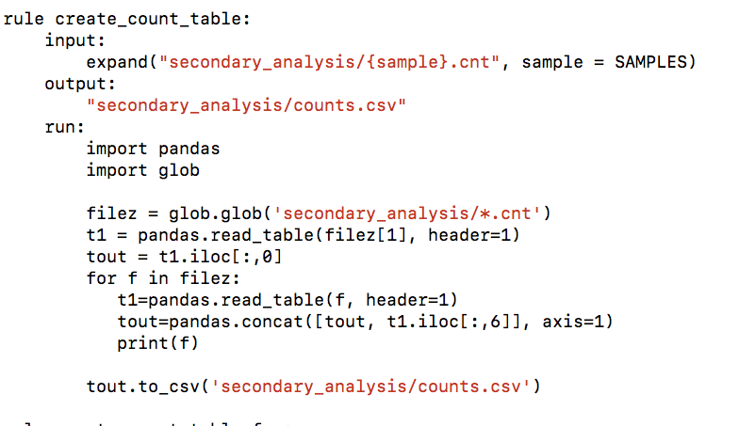
Snakefile – rules with python

Slide 8
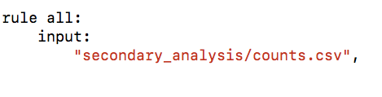
One rule… to rule them all

Slide 9

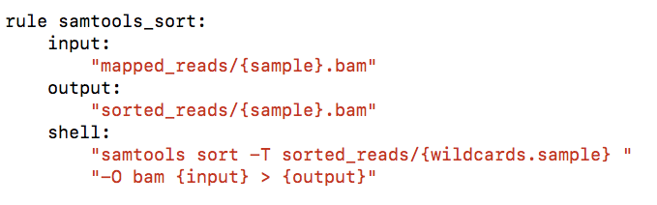
Snakefile – wildcards: generating contents and use

Slide 10
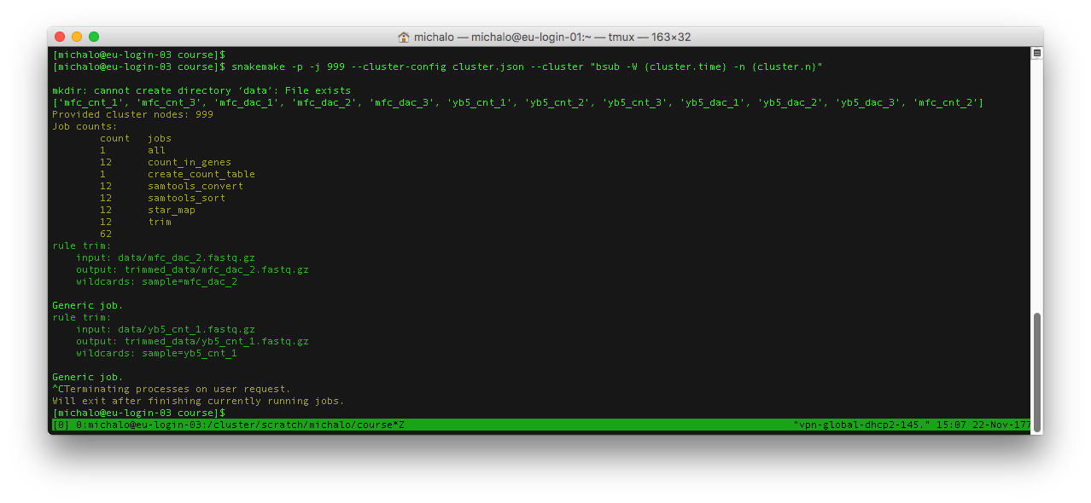
Running snakemake on the cluster

Slide 11
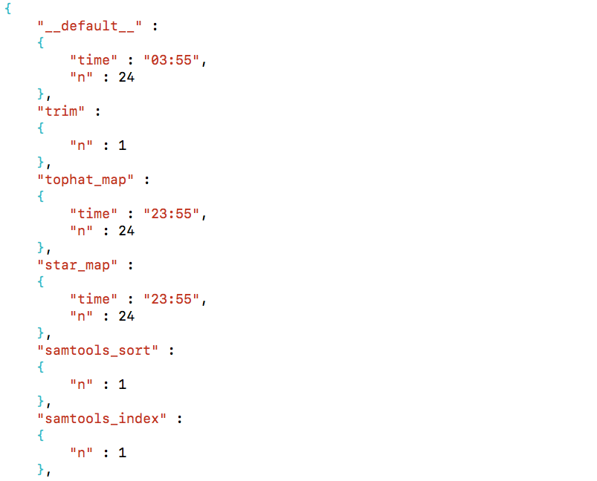
Cluster settings: cluster.json

Slide 12
What we actually do in snakemake?
Directed acycylic graph of jobs
Can be seen with
  snakemake --dag > graph.dag
  dot -Tpdf graph.dag > aaa.pdf
Visualizes dependencies of rules

Slide 13
What we actually do in snakemake?

Slide 14
Other examples of rules graph

Slide 15
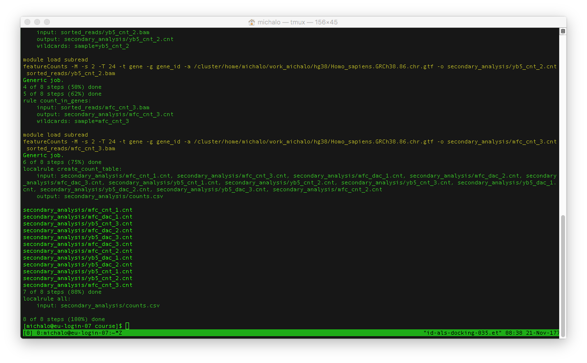
Snakemake happily finished

Slide 16
Starting snakemake on Euler
[sfux@eu-login-20-ng ~]$ module load new gcc/4.8.2 python/3.6.1
Autoloading openblas/0.2.13_seq
[sfux@eu-login-20-ng ~]$ snakemake --version
5.3.0

Slide 17
Other reproducibility mechanisms that can be used by snakemake
Common Workflow Language
Remote files
Integrated package management with Conda
Running jobs in containers
Wrappers

Slide 18
Practical advice
Test your workflow with a “dry run”: snakemake –np
Real run test – with small number of input files, eg 3
On the cluster
  run snakemake in a screen session on a login node
  run snakemake on personal scratch or other permanent storage
  use local rules whenever possible
  I/O rules – define as single core jobs in cluster.json
  check time, memory, cores settings for each job
Consider deleting intermediate files after use
Sometimes deleting .snakemake may be needed for re-run

Slide 19
Easy examples and proper workflows
Simple eductational example
  https://github.com/michalogit/snakemaketax
Template of RNA-seq primary analysis with hisat2, for laptop and Euler
  https://github.com/michalogit/snake_hisat
The workflow for Covid variant calling used in production mode on Euler
  https://github.com/cbg-ethz/V-pipe

Slide 20
Advantages and difficulties of snakemake
Reproducibility
Control over workflow
  Re-running
Encapsulation of typical tasks
“One-click” starting of a large process
You need to “speak python” a bit
Learning curve steep at the beginning

Slide 21

Snakemake

