Slide 1

High Performance Computing for genomic applications
Various aspects of RNAseq analysis
Scientific IT Services
Michal Okoniewski

Slide 2
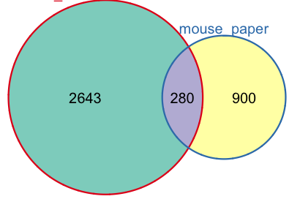
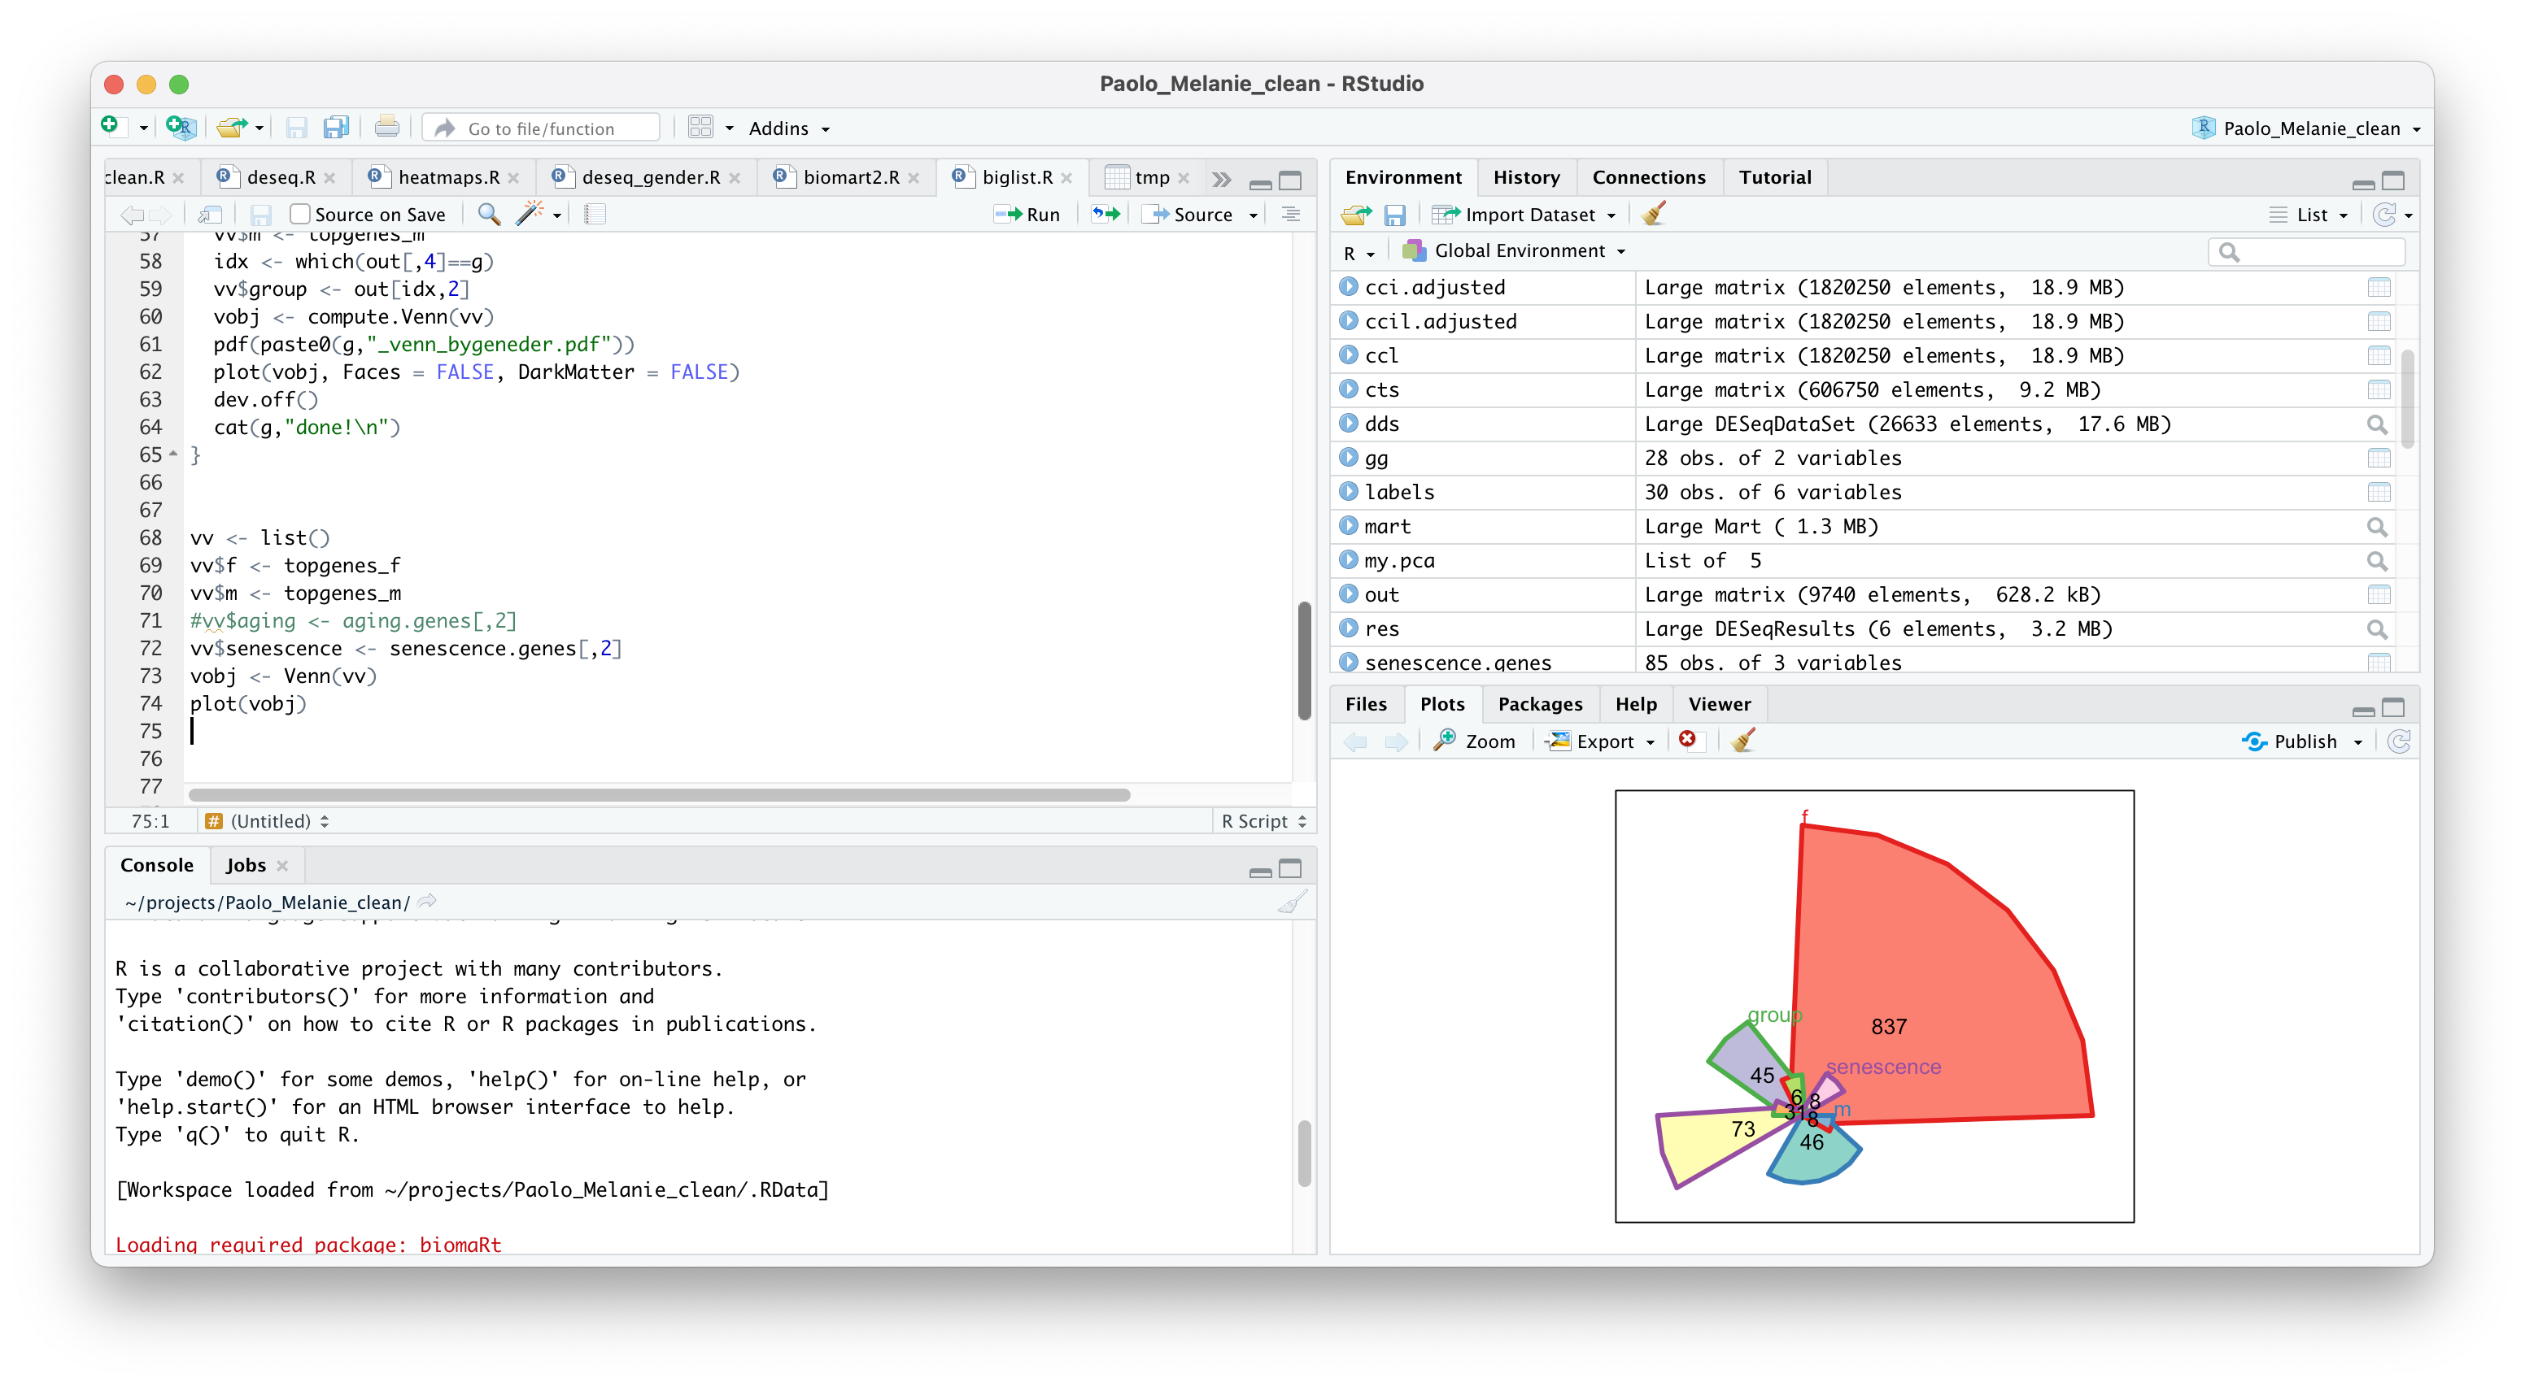
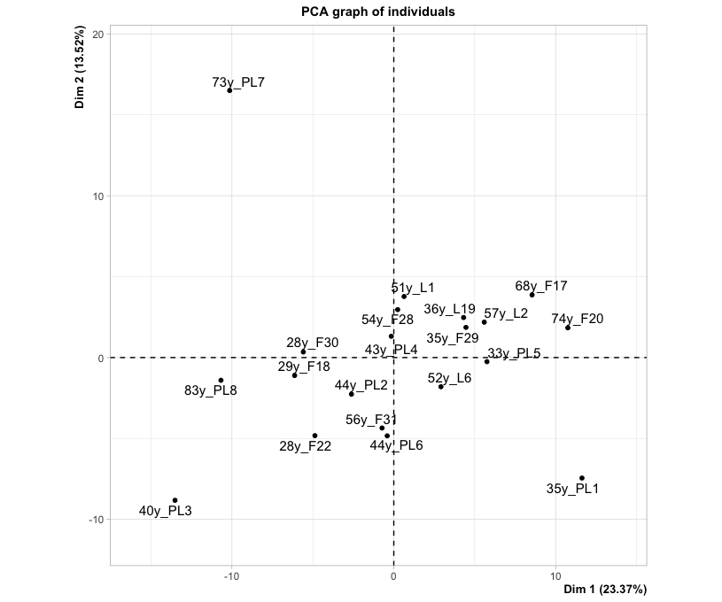
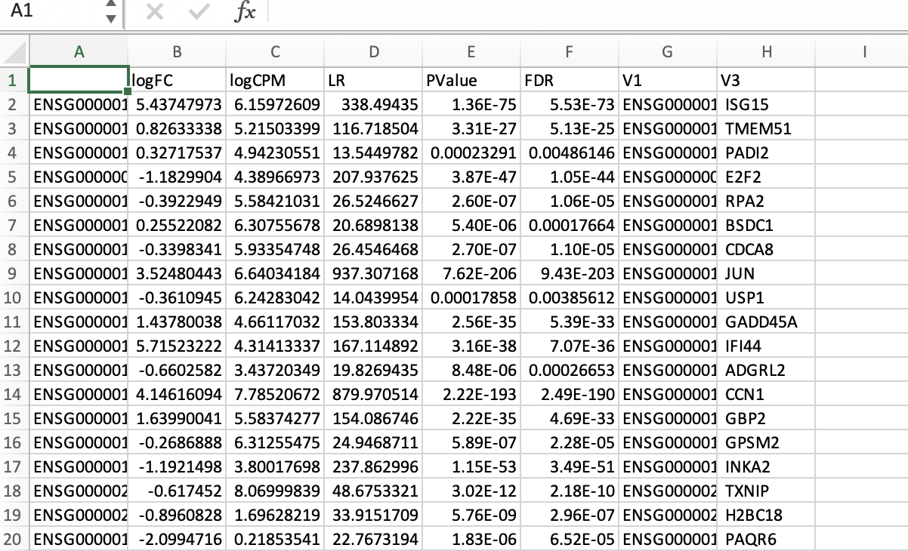
Current toolbox for RNAseq
Fastq
from sequencing
Fastq
trimmed
BAM
count table
trimming
alignment
counting
Into R
Samples
QC
Functional analysis
Diff expression

Slide 3
Result table

Slide 4

RNAseq
Enjoy

